Slide 1
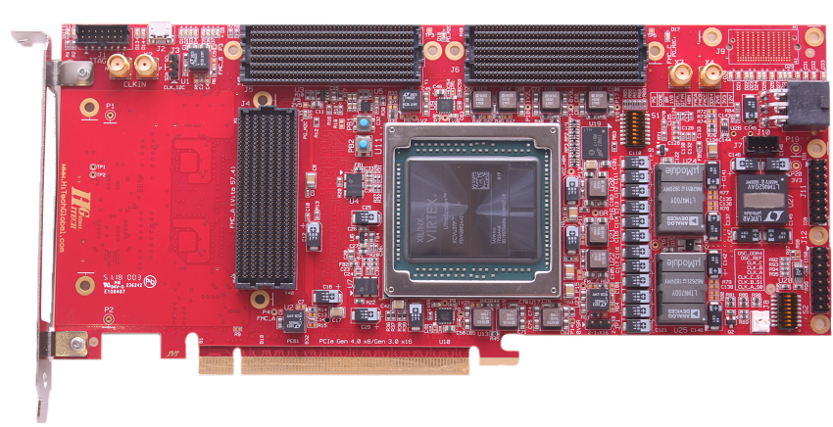
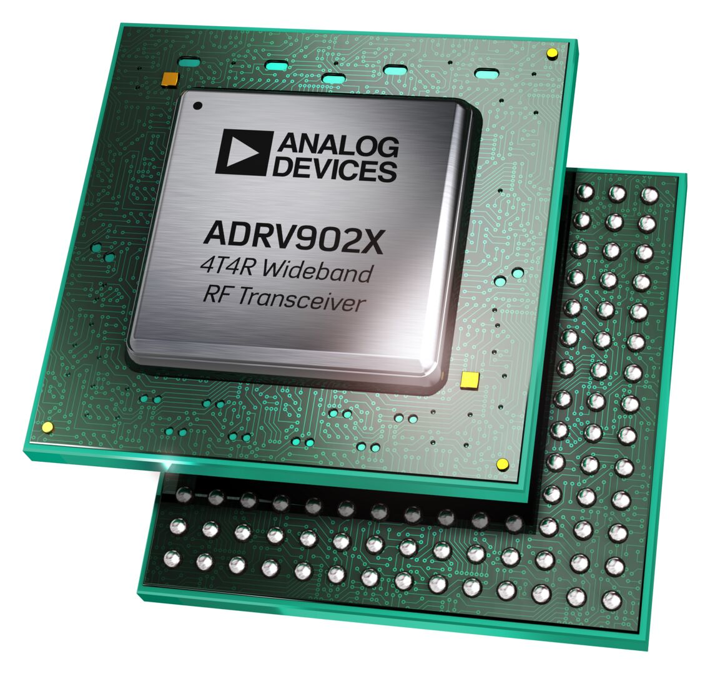
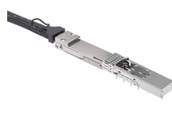
Search by Application: µModule Regulators
FPGAs
Optical Modules
Transceivers
Data Converters, RF
Healthcare
Automotive
Defense
Data Center
Automated Test Equipment

Slide 2
µModule Regulators for Optical Modules
Function | Package |  |  | V_{IN} | V_{OUT} | I_{OUT} | Part #
 | X-Y (sort) | Height | Place on Topside or Backside PCB QSFP-DD, -28, OSFP
Step-Down (Buck) | 3 x 4mm | 1.18mm LGA 1.48mm BGA | Backside & Topside | 2.25V to 3.6V | 0.5 to 2.5V | Dual 2A | LTM4691
 | 4 x 4mm | 4.32mm LGA 4.62mm BGA | Topside | 2.25V to 5.5V | 0.5V to V_{IN} | 10A | LTM4658
 | 4 x 4mm | 1.43mm LGA | Backside & Topside | 2.25V to 5.5V | 0.5V to V_{IN} | 10A | LTM4659
 | 4 x 4mm | 2.1mm BGA | Topside | 2.7V to 17V | 0.6V to 1.8V | Quad 1.2A | LTM4668
 |  |  |  |  | 0.6V to 5.5V |  | LTM4668A
 | 6 x 12mm | 3.53mm BGA | Topside | 2.5V to 5.5V | 0.4V to 3.6V | Quad 8A Silent Switcher | LTM4710-1
Step Up & Down (Buck-Boost) | 3.5 x 4mm | 1.25mm LGA | Backside & Topside | 2.6V to 5.5V | 1.8V to 5.5V | Buck & Buck-Boost: 2A Boost: 1A | LTM4693
TEC (Thermoelectric Cooler) | 3.5 x 4mm | 1.3mm LGA | Backside & Topside | 2.7V to 5.5V | -V_{IN} to +V_{IN} | 1.5A | LTM4663
Notes:
LTM4670 (Quad 10A)

Slide 3
µModule Regulators for Transceivers
ADRV902x Transceivers:
Package |  | V_{IN} | V_{OUT} | I_{OUT} (sort) | Part #
9.5 x 16mm | 4.72mm BGA | 3.1V to 20V | Dual 12A: 0.6V to 3.3V Dual 5A: 0.6V to 5.5V | Dual 12A & Dual 5A | LTM4671
16 x 16mm | 4.82mm BGA | 3.1V to 15V | Dual 12A: 0.6V to 3.6V Dual 5A: 0.6V to 5.5V | Dual 12A & Dual 5A with PMBus | Contact uModule Team
6.25 x 6.25mm | 5.02mm BGA | 2.7V to 18V | 0V to 6V | Single 8A Silent Switcher | Contact uModule Team
11 x 22mm | 8.32mm BGA | 4.5V to 20V (2.375V with 5V Bias) | Dual 20A: 0.6V to 3.3V Dual 5A: 0.6V to 3.3V | Dual 20A & Dual 5A | Contact uModule Team

Slide 4
µModule® Regulators for Data Converters, RF
Function | # of Output | Input Voltage (V) |  | Output Voltage (V) |  | Output Current (A) | EMI Standard | Silent Switcher® Architecture | Package |  |  | Part Number
 |  | Min | Max | Min | Max |  |  |  | Dimensions (mm) | Height (mm) | Package
Step-Down | 1 | 4 | 36 | 1.25 | 5 | 0.2A | EN55022 Class B | - | 6.25 x 6.25 | 2.32 | LGA | LTM8020
 |  | 3 | 36 | 0.8 | 5 | 0.5A | CISPR22 Class B | - | 6.25 x 11.25 | 2.82 | LGA | LTM8021
 |  | 3.6 | 36 | 0.8 | 10 | 1A | EN55022 Class B | - | 9 x 15 | 2.82 | LGA | LTM8031
 |  | 3.2 | 40 | 0.8 | 12 | 1.2A | CISPR22 Class B | Yes | 4 x 4 | 1.82 | BGA | LTM8074
 |  | 3.6 | 36 | 0.8 | 10 | 2A | EN55022 Class B | - | 9 x 15 | 2.82 3.42 | LGA BGA | LTM8032
 |  | 3.2 | 40 | 0.8 | 15 | 2A | CISPR22 Class B | Yes | 4 x 6.25 | 2.22 | BGA | LTM8063
 |  | 3.4 | 40 | 0.97 | 18 | 2.5A | CISPR22 Class B | Yes | 6.25 x 6.25 | 2.32 | BGA | LTM8065
 |  | 3.4 | 40 | 0.97 | 18 | 2.8A | CISPR25 Class 5 | Yes | 6.25 x 6.25 | 2.22 | BGA | LTM8002
 |  | 3.6 | 36 | 0.8 | 24 | 3A | EN55022 Class B | - | 11.25 x 15 | 4.32 4.92 | LGA BGA | LTM8033
 |  | 4 2.375 with External Bias | 20 | 0.6 | 5.5 | 3A | EN55022 Class B | - | 6.25 x 6.25 | 1.82 2.42 | LGA BGA | LTM4623
 |  | 3.4 | 60 | 0.8 | 15 | 3A | CISPR22 Class B | Yes | 6.25 x 9 | 3.32 | BGA | LTM8073
 |  | 3.4 | 40 | 0.97 | 15 | 3.5A | CISPR22 Class B | Yes | 6.25 x 9 | 3.32 | BGA | LTM8053 / LTM8053-1
 |  | 3.4 | 40 | 0.97 | 18 | 3.5A | CISPR25 Class 5 | Yes | 6.25 x 9 | 3.32 | BGA | LTM8003
 |  | 3.1 | 58 | 0.5 | 0.94*Vin | 4A | EN55022 Class B | - | 9 x 15 | 5.01 | BGA | LTM4653
 |  | 3.6 | 60 | 0.97 | 15 | 5A | CISPR22 Class B | Yes | 9 x 11.25 | 3.32 | BGA | LTM8071
 |  | 5 | 36 | 3.3 | 15 | 5A | EN55022 Class B | - | 15 x 15 | 2.8 | LGA | LTM4612
 |  | 4.5 | 28 | 0.6 | 5 | 6A | EN55022 Class B | - | 15 x 15 | 2.82 3.42 | LGA BGA | LTM4606
 |  | 5 | 36 | 3.3 | 15 | 8A | EN55022 Class B | - | 15 x 15 | 4.32 4.92 | LGA BGA | LTM4613
 | 2 | 3 | 40 | 0.8 | 10 | Dual 1.4A or Single 2.8A | CISPR22 Class B | Yes | 6.25 x 6.25 | 2.22 | BGA | LTM8078
 |  | 3 | 40 | 0.8 | 8 | Dual 3.5A or Single 7A | CISPR22 Class B | Yes | 9 x 11.25 | 3.32 | BGA | LTM8024
 | 4 | 3 | 40 | 0.8 | 8 | Quad 1.2A | CISPR22 Class B CISPR25 Class 5 | Yes | 6.25 x 11.25 | 2.22 | BGA | LTM8051
 |  | 3 | 40 | 0.8 | 8 | Quad 3A |  | Yes | 11.9 x 16 | 3.32 | BGA | LTM8060
µModule Regulators
Show me Ultrathin
Show me
New Products
(2020,21,22)
Show me
Pin-Compatible
Show me
Silent Switcher

Slide 5
FPGA Reference Designs
Supplier Verified Reference Designs
16nm UltraScale+ | 20nm UltraScale | 28nm 7-Series
Virtex UltraScale+ | Virtex UltraScale | Virtex 7
 | Kintex UltraScale | Kintex 7
Versal Series | Zynq
AI Core | UltraScale+ MPSoC
Prime | UltraScale+ RFSoC
 | Zynq-7000 SoC
MAX | Cyclone | Arria | Stratix
MAX 10 (2014, 55 nm) | Cyclone 10 (2017) | Arria 10 (2013, 20nm) | Stratix 10 (2013, 14nm)
 | Cyclone V (2011) | Arria V (2012, 28nm) | Stratix V (2010, 28nm)
 | Cyclone IV (2009) |  | Stratix IV (2008, 40nm)
Click here for Cross Reference to Enpirion Modules

Slide 6
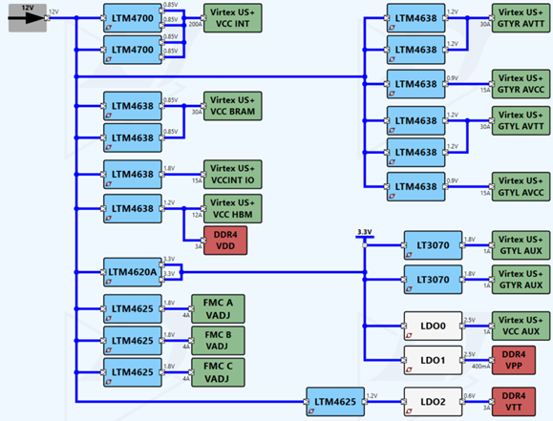
Power for Xilinx Virtex UltraScale+ Page 1 of 4
 |  | Need Higher Power? | Need Lower Power?
Core | LTM4700 | LTM4681 | LTM4680, LTM4678 LTM4677
I/O | LTM4620A | LTM4662, LTM4630A, LTM4650A | LTM4631, LTM4628 LTM4646
Auxiliary | LTM4625 | LTM4657, LTM4626 LTM4638, LTM4705 | LTM4623, LTM4624 LTM4622, LTM4668, LTM4668A
VCC_BRAM GTYR_AVCC, GTYL_AVCC VCC_HBM, GTYR_AVTT, GYTL_AVTT VCCINT_IO | LTM4638 | LTM4645, LTM4620, LTM4630 | LTM4626, LTM4657, LTM4705
Xilinx Virtex UltraScale+ VU37P or VU47P
Reference design:
ADI Website
HiTechGlobal Website:
http://www.hitechglobal.com/index.htm

Slide 7
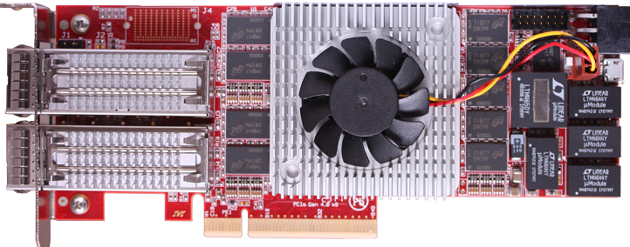
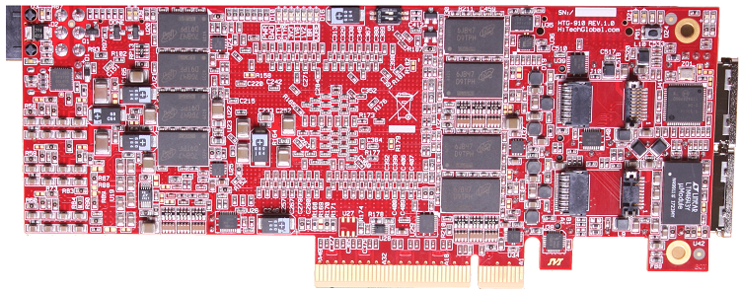
Power for Xilinx Virtex UltraScale+ Page 2 of 4
 |  | Need Higher Power? | Need Lower Power?
Core | LTM4650 | LTM4678, LTM4680 LTM4700, LTM4681 | LTM4630, LTM4677 LTM4662, LTM4636, LTM4647
I/O, Memory, PORTs | LTM4643 | LTM4644 | LTM4632, LTM4668, LTM4625, LTM4624
VCC_BRAM, VCCINT_IO, GTYR_AVCC, GTYL_AVCC GTYR_AVTT, GTYL_AVTT, DDR4 VTT, VCCAUX | LTM4644 | LTM4671 | LTM4643
Xilinx Virtex UltraScale+ VU5P, VU9P, VU13P or UltraScale VU190
Reference design:
(backside)
ADI Website
HiTechGlobal Website:
http://www.hitechglobal.com/index.htm

Slide 8
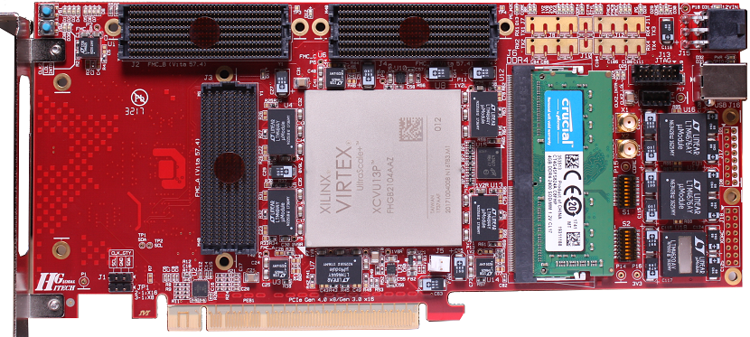
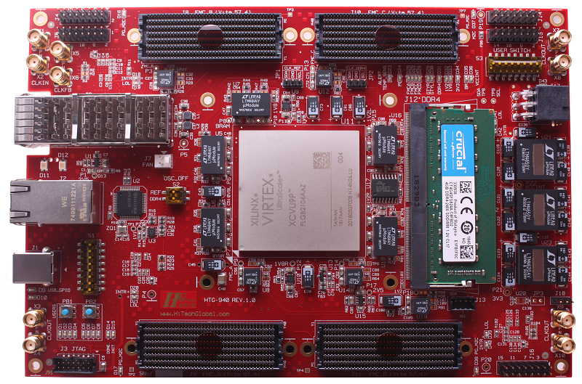
Power for Xilinx Virtex UltraScale+ Page 3 of 4
 | Need Higher Power? | Need Lower Power?
LTM4676A | LTM4677, LTM4678, LTM4680, LTM4700, LTM4681 | LTM4686, LTM4675
LTM4650 | LTM4678, LTM4680 LTM4700, LTM4681 | LTM4630, LTM4677 LTM4662, LTM4636, LTM4647
LTM4620A | LTM4662, LTM4630A, LTM4650A | LTM4631, LTM4628 LTM4646
LTM4644 | LTM4671 | LTM4643
Xilinx Virtex UltraScale+ VU9P, VU13P, or UltraScale VU190
Reference design:
HiTechGlobal Website:
http://www.hitechglobal.com/index.htm
Notes:
We know what we know

Slide 9
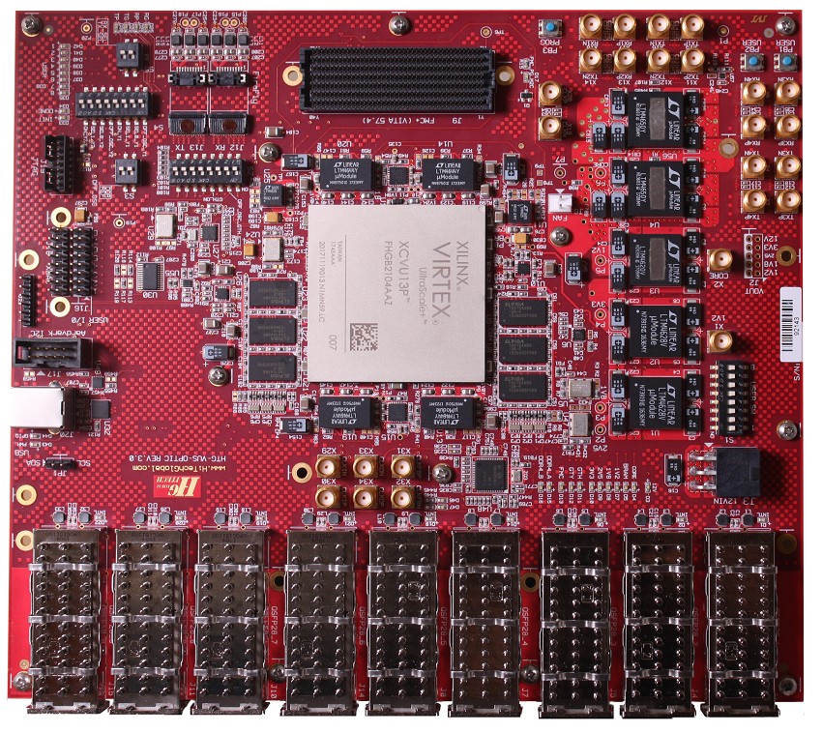
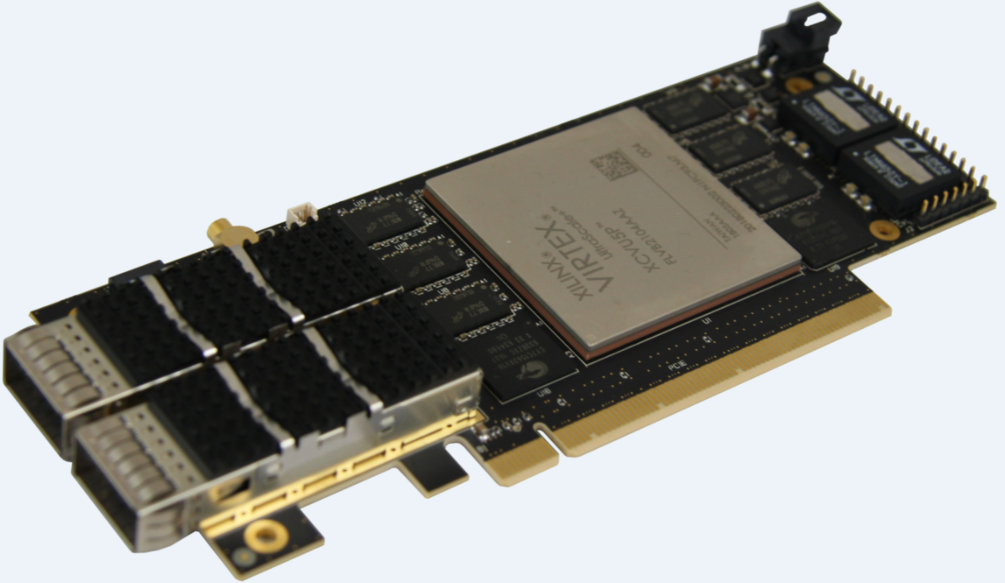
Power for Xilinx Virtex UltraScale+ Page 4 of 4
 | Need Higher Power? | Need Lower Power?
LTM4650 | LTM4678, LTM4680 LTM4700, LTM4681 | LTM4630, LTM4677 LTM4662, LTM4636, LTM4647
LTM4620 | LTM4662, LTM4630, LTM4650 | LTM4631, LTM4628 LTM4646
LTM4628 | LTM4631, LTM4620, LTM4630, LTM4650 | LTM4705, LTM4642
LTM4644 | LTM4671 | LTM4643
Xilinx Virtex UltraScale+ VU13P, VU9P, or UltraScale VU190
Reference design:
ReflexCES Website
HiTechGlobal Website:
http://www.hitechglobal.com/index.htm

Slide 10
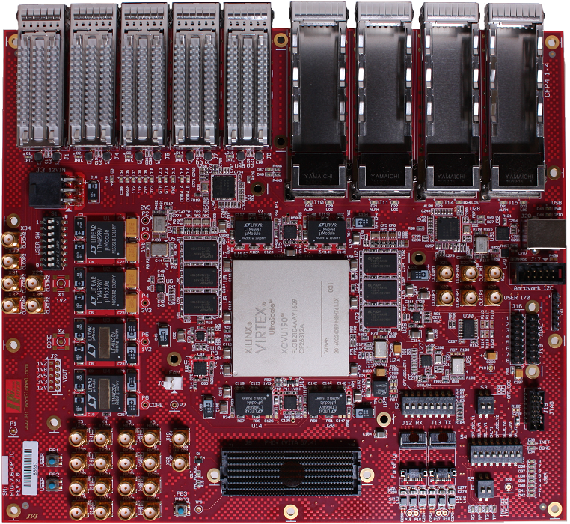
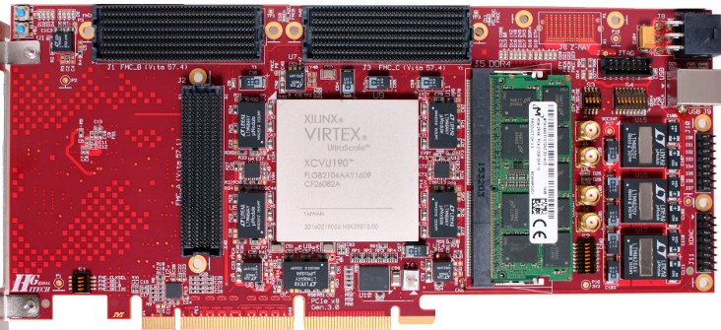
Power for Xilinx Virtex Ultrascale Page 1 of 3
 |  | Need Higher Power? | Need Lower Power?
Core | LTM4620 | LTM4662, LTM4630, LTM4650 | LTM4631, LTM4628, LTM4646
System | LTM4628 | LTM4631, LTM4620, LTM4630, LTM4650 | LTM4705, LTM4642
MGT | LTM4644 | LTM4671 | LTM4643
System | LTM4625 | LTM4657, LTM4626 LTM4638, LTM4705 | LTM4623, LTM4624 LTM4622, LTM4668
Xilinx Virtex UltraScale 095, 125, or 190
 |  | Need Higher Power? | Need Lower Power?
Core | LTM4620 | LTM4662, LTM4630, LTM4650 | LTM4631, LTM4628, LTM4646
FMC | LTM4620A
BRAM GTX/GTY | LTM4644 | LTM4671 | LTM4643
DDR FMC | LTM4625 | LTM4657, LTM4626 LTM4638, LTM4705 | LTM4623, LTM4624 LTM4622, LTM4668
Xilinx Virtex UltraScale VU190, 160, 125, 095,
or Kintex UltraScale KU115
Reference design:
ADI Website
HiTechGlobal Website: http://www.hitechglobal.com/index.htm

Slide 11
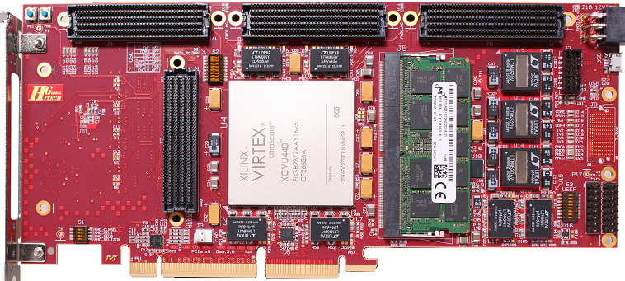
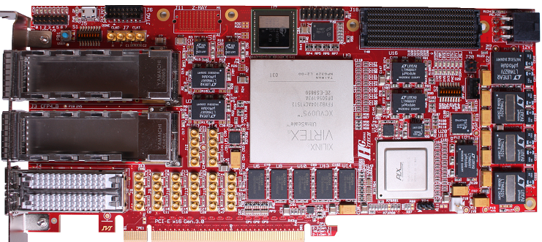
Power for Xilinx Virtex Ultrascale Page 2 of 3
 | Need Higher Power? | Need Lower Power?
LTM4620 | LTM4662, LTM4630, LTM4650 | LTM4631, LTM4628, LTM4646
LTM4644 | LTM4671 | LTM4643
Xilinx Virtex UltraScale VU440
 | Need Higher Power? | Need Lower Power?
LTM4627 | LTM4631, LTM4620, LTM4646, LTM4662 | LTM4601, LTM4626, LTM4701, LTM4600, LTM4649
LTM4620 | LTM4662, LTM4630, LTM4650 | LTM4631, LTM4628, LTM4646
LTM4644 | LTM4671 | LTM4643
Xilinx Virtex UltraScale VU080, 095, 125, 160, or 190
Reference design:
HiTechGlobal Website:
http://www.hitechglobal.com/index.htm

Slide 12
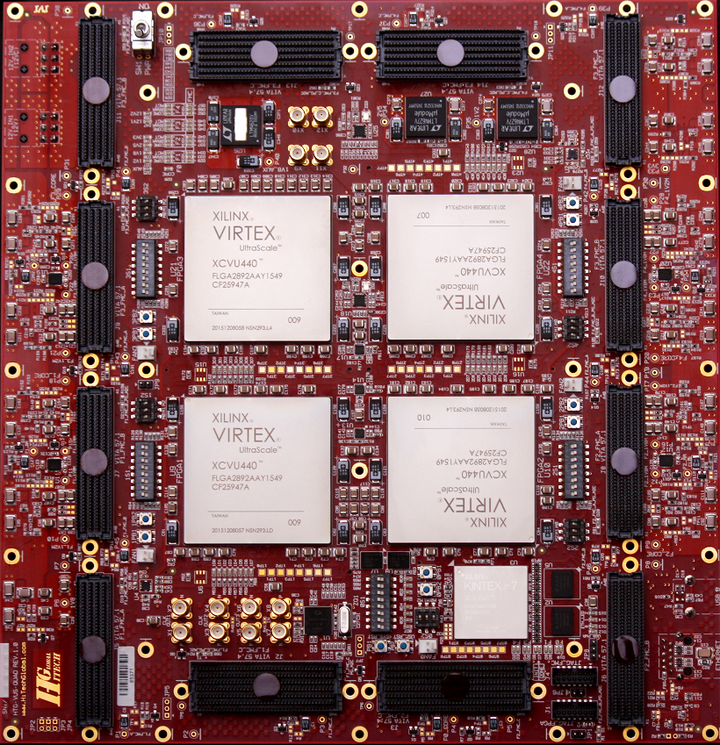
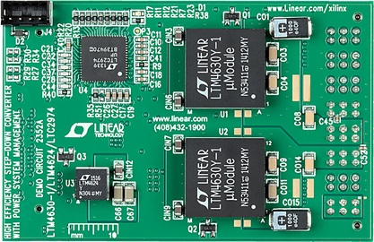
Power for Xilinx Virtex Ultrascale Page 3 of 3
 | Need Higher Power? | Need Lower Power?
LTM4620 | LTM4662, LTM4630, LTM4650 | LTM4631, LTM4628, LTM4646
LTM4627 | LTM4631, LTM4620, LTM4646, LTM4662 | LTM4601, LTM4626, LTM4701, LTM4600, LTM4649
Xilinx Virtex UltraScale Quad VU440
 | Need Higher Power? | Need Lower Power?
LTM4630-1 | LTM4650, LTM4678, LTM4680, LTM4700, LTM4671 | LTM4620, LTM4631, LTM4628, LTM4646
LTM4624 | LTM4625, LTM4622, LTM4657, LTM4626, LTM4705 | LTM4623, LTM4668
Xilinx Virtex UltraScale MGTs (Multi-Gigabit Transceivers)
Reference design:
ADI Website
HiTechGlobal Website: http://www.hitechglobal.com/index.htm

Slide 13
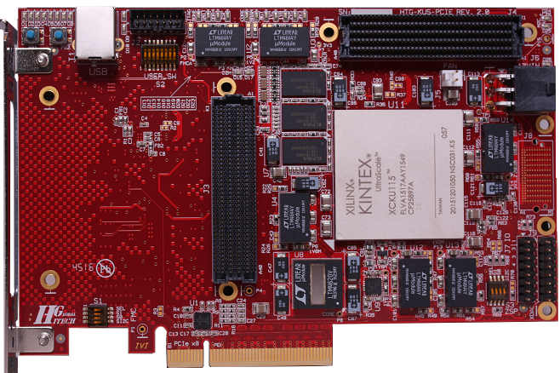
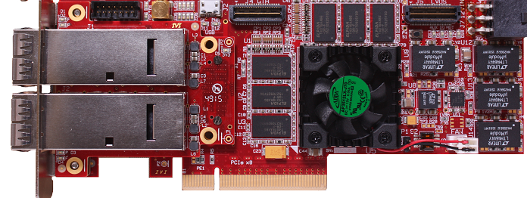
Power for Xilinx Kintex Ultrascale Page 1 of 2
 |  | Need Higher Power? | Need Lower Power?
Core | LTM4620 | LTM4662, LTM4630, LTM4650 | LTM4631, LTM4628, LTM4646
MGTAVCC, MGTAVTT, HMC, VCCBRAM, System Power, FMC, VDD_HMC | LTM4644 | LTM4671 | LTM4643
Xilinx Kintex UltraScale XCKU-60, 85 or 115
 |  | Need Higher Power? | Need Lower Power?
Core, System Power, MGT/MGY | LTM4644 | LTM4671 | LTM4643
BRAM | LTM4625 | LTM4657, LTM4626 LTM4638, LTM4705 | LTM4623, LTM4624 LTM4622, LTM4668
Xilinx Kintex UltraScale XCKU-40 or 60
Reference design:
HiTechGlobal Website:
http://www.hitechglobal.com/index.htm

Slide 14
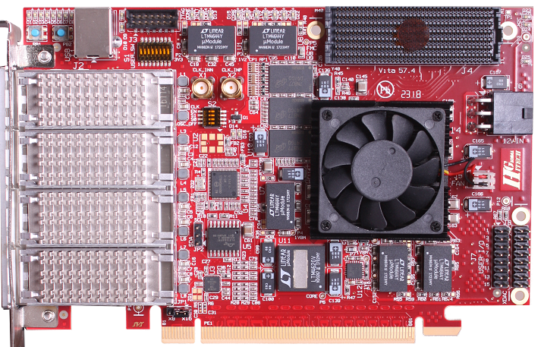
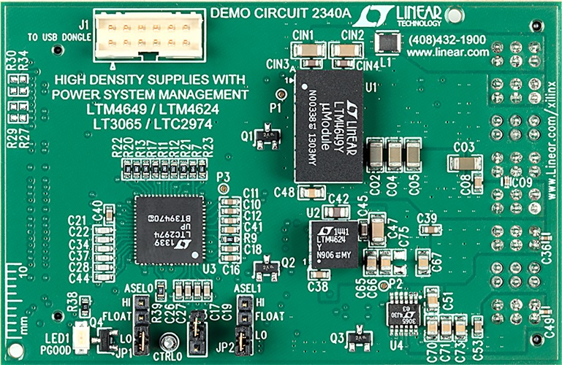
Power for Xilinx Kintex Ultrascale Page 2 of 2
 | Need Higher Power? | Need Lower Power?
LTM4620 | LTM4662, LTM4630, LTM4650 | LTM4631, LTM4628, LTM4646
LTM4644 | LTM4671 | LTM4643
Xilinx Kintex UltraScale XCKU-085 or 115
 | Need Higher Power? | Need Lower Power?
LTM4649 | LTM4626, LTM4627, LTM4638, LTM4628, LTM4620 | LTM4657, LTM4625
LTM4624 | LTM4625, LTM4622, LTM4657 | LTM4623
Xilinx Kintex UltraScale MGTs (Multi-Gigabit Transceivers)
Reference design:
ADI Website
HiTechGlobal Website:
http://www.hitechglobal.com/index.htm

Slide 15
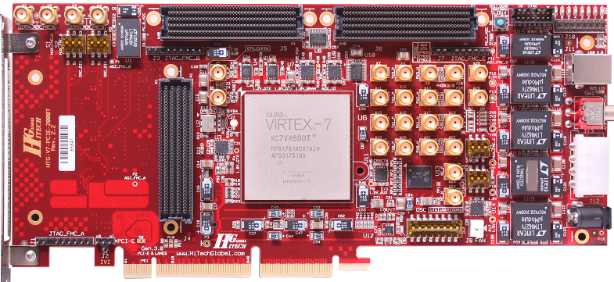
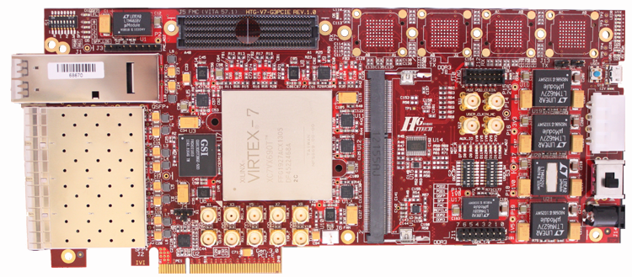
Power for Xilinx Virtex 7 Page 1 of 4
 | Need Higher Power? | Need Lower Power?
LTM4618 | LTM4657, LTM4649, LTM4600, LTM4626, LTM4627, LTM4638 | LTM4625, LTM4624, LTM4622, LTM4622A, LTM4623
LTM4627 | LTM4631, LTM4620, LTM4646, LTM4662 | LTM4601, LTM4626, LTM4701, LTM4600, LTM4649
LTM4620 | LTM4662, LTM4630, LTM4650 | LTM4631, LTM4628, LTM4646
Xilinx Virtex-7 V2000T, V585, or X690T
Reference design:
ADI Website
HiTechGlobal Website:
http://www.hitechglobal.com/index.htm
Xilinx Virtex-7 X415T, X485T, X550T, or X690T

Slide 16
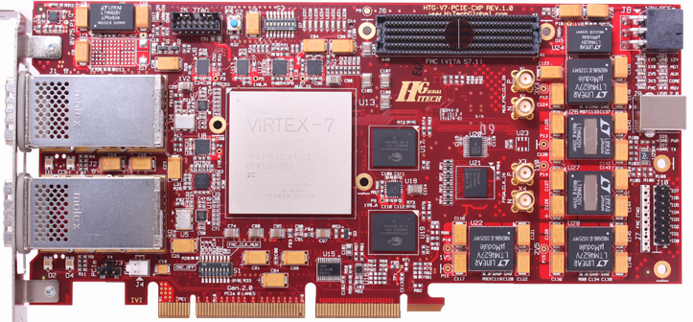
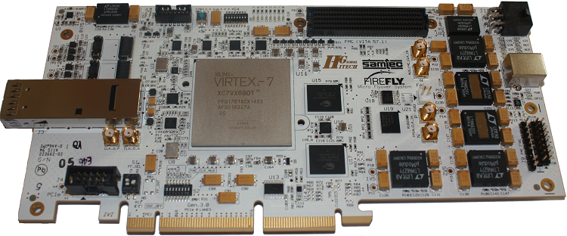
Power for Xilinx Virtex 7 Page 2 of 4
 | Need Higher Power? | Need Lower Power?
LTM4618 | LTM4657, LTM4649, LTM4600, LTM4626, LTM4627, LTM4638 | LTM4625, LTM4624, LTM4622, LTM4622A, LTM4623
LTM4627 | LTM4631, LTM4620, LTM4646, LTM4662 | LTM4601, LTM4626, LTM4701, LTM4600, LTM4649
LTM4620 | LTM4662, LTM4630, LTM4650 | LTM4631, LTM4628, LTM4646
Xilinx Virtex-7 V2000T, V585, or X690T
Reference design:
ADI Website
HiTechGlobal Website:
http://www.hitechglobal.com/index.htm
Xilinx Virtex-7 V2000T, V585T, or X690T

Slide 17
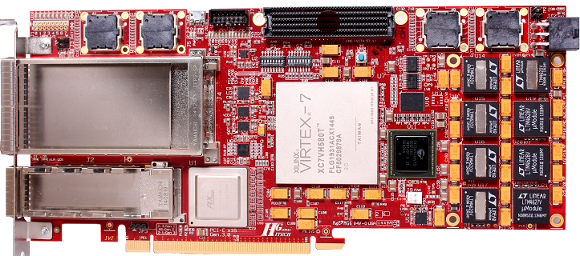
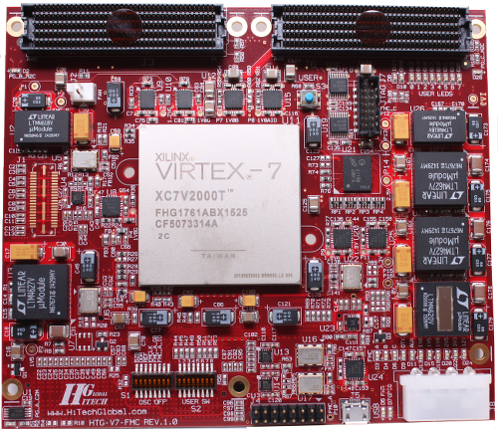
Power for Xilinx Virtex 7 Page 3 of 4
 | Need Higher Power? | Need Lower Power?
LTM4620 | LTM4662, LTM4630, LTM4650 | LTM4631, LTM4628, LTM4646
LTM4627 | LTM4631, LTM4620, LTM4646, LTM4662 | LTM4601, LTM4626, LTM4701, LTM4600, LTM4649
LTM4628 | LTM4631, LTM4620, LTM4630, LTM4650 | LTM4705, LTM4642
Xilinx Virtex-7 H580T
 | Need Higher Power? | Need Lower Power?
LTM4618 | LTM4657, LTM4649, LTM4600, LTM4626, LTM4627, LTM4638 | LTM4625, LTM4624, LTM4622, LTM4622A, LTM4623
LTM4627 | LTM4631, LTM4620, LTM4646, LTM4662 | LTM4601, LTM4626, LTM4701, LTM4600, LTM4649
LTM4620 | LTM4662, LTM4630, LTM4650 | LTM4631, LTM4628, LTM4646
Reference design:
ADI Website
HiTechGlobal Website: http://www.hitechglobal.com/index.htm
Xilinx Virtex-7 V2000T, X690T, or V585T

Slide 18
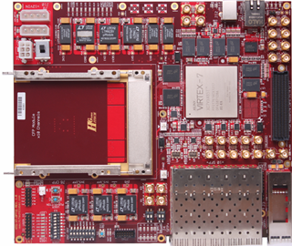
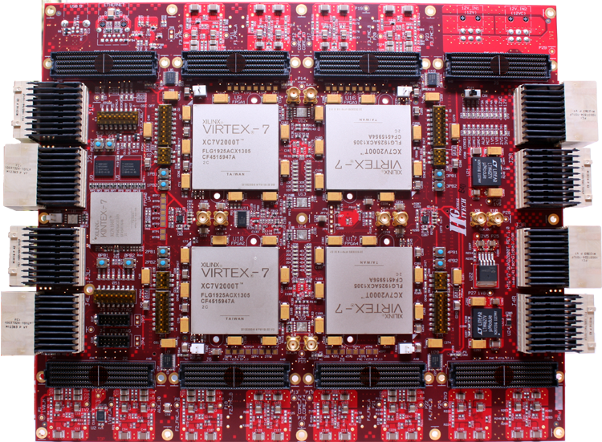
Power for Xilinx Virtex 7 Page 4 of 4
 | Need Higher Power? | Need Lower Power?
LTM4618 | LTM4657, LTM4649, LTM4600, LTM4626, LTM4627, LTM4638 | LTM4625, LTM4624, LTM4622, LTM4622A, LTM4623
LTM4620 | LTM4662, LTM4630, LTM4650 | LTM4631, LTM4628, LTM4646
LTM4627 | LTM4631, LTM4620, LTM4646, LTM4662 | LTM4601, LTM4626, LTM4701, LTM4600, LTM4649
LTM4628 | LTM4631, LTM4620, LTM4630, LTM4650 | LTM4705, LTM4642
Xilinx Virtex-7 X485T, X690T, or V2000T
 | Need Higher Power? | Need Lower Power?
LTM4627 | LTM4631, LTM4620, LTM4646, LTM4662 | LTM4601, LTM4626, LTM4701, LTM4600, LTM4649
Reference design:
ADI Website
HiTechGlobal Website:
http://www.hitechglobal.com/index.htm
Xilinx Virtex-7 V2000Ts

Slide 19
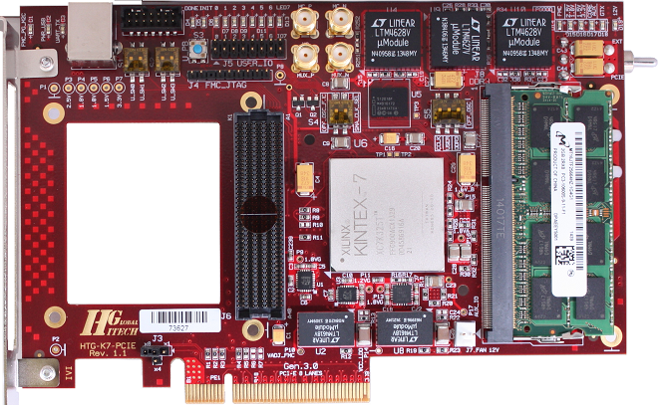
Power for Xilinx Kintex 7
 |  | Need Higher Power? | Need Lower Power?
Core | LTM4627 | LTM4631, LTM4620, LTM4646, LTM4662 | LTM4601, LTM4626, LTM4701, LTM4600, LTM4649
System Power, FMC | LTM4618 | LTM4657, LTM4649, LTM4600, LTM4626, LTM4627, LTM4638 | LTM4625, LTM4624, LTM4622, LTM4622A, LTM4623
System Power, I/O | LTM4628 | LTM4631, LTM4620, LTM4630, LTM4650 | LTM4705, LTM4642
Xilinx Kintex-7 K325T or K410T
Reference design:
ADI Website
HiTechGlobal Website:
http://www.hitechglobal.com/index.htm

Slide 20
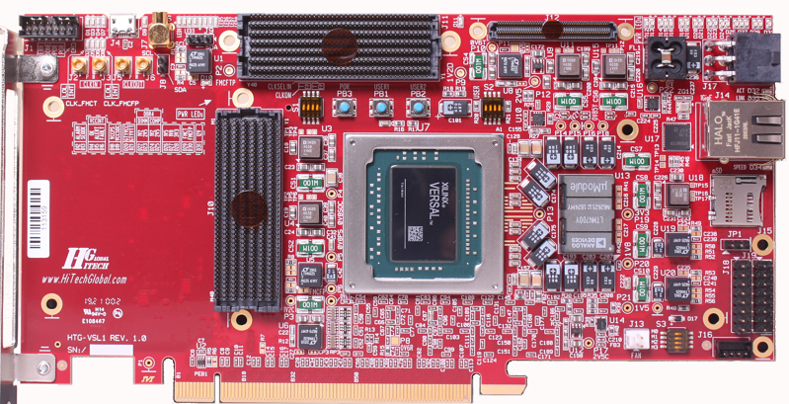
Power for Xilinx Versal Prime / AI
 | Need Higher Power? | Need Lower Power?
LTM4700 | LTM4681 (Quad 31.25A) | LTM4680, LTM4678 LTM4677
LTM4625 | LTM4657, LTM4626 LTM4638, LTM4705 | LTM4623, LTM4624 LTM4622, LTM4668
LTM4638 | LTM4645, LTM4620, LTM4630 | LTM4626, LTM4657, LTM4705
Reference design:
Xilinx Versal XCVM1802 (PRIME) or XCVC1902 (AI)
HiTechGlobal Website:
http://www.hitechglobal.com/index.htm

Slide 21
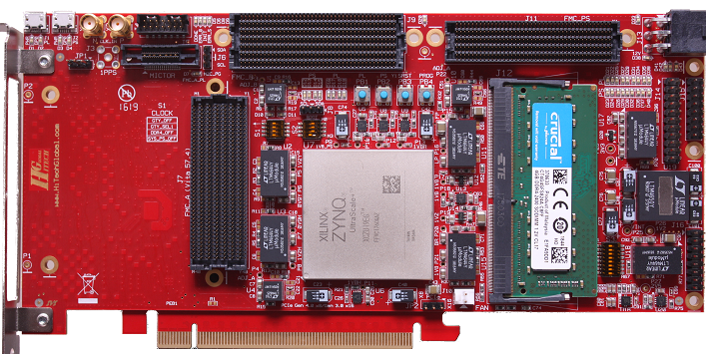
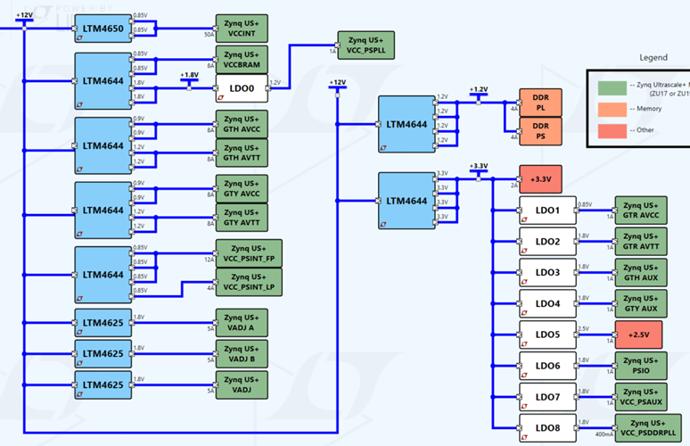
Power for Xilinx ZYNQ UltraScale+ MPSoC Page 1 of 2
 |  | Need Higher Power? | Need Lower Power?
Core | LTM4650 | LTM4678, LTM4680 LTM4700, LTM4681 (all with PMBus) | LTM4630, LTM4636 LTM4677 (PMBus)
I/O | LTM4644 | LTM4671 | LTM4643, LTM4668
Auxiliary | LTM4625 | LTM4657, LTM4626, LTM4638, LTM4705 | LTM4623, LTM4624, LTM4622
Xilinx ZYNQ UltraScale+ ZU11-3, ZU19-2 or XQZU19EG (defense grade)
Reference design:
ADI Website
HiTechGlobal Website:
http://www.hitechglobal.com/index.htm

Slide 22
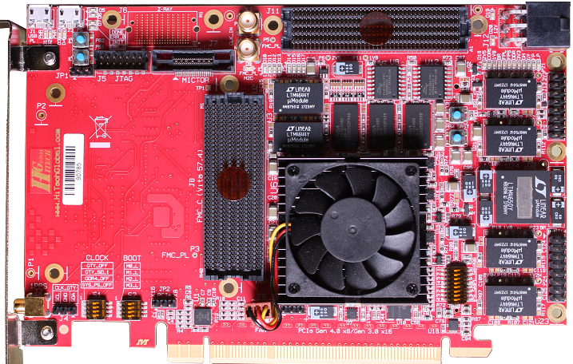
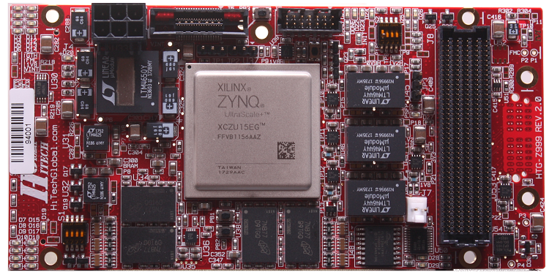
Power for Xilinx ZYNQ UltraScale+ MPSoC Page 2 of 2
 | Need Higher Power? | Need Lower Power?
LTM4650 | LTM4678, LTM4680 LTM4700, LTM4681 (all with PMBus) | LTM4630, LTM4636 LTM4677 (PMBus)
LTM4644 | LTM4671 | LTM4643, LTM4668
Xilinx ZYNQ UltraScale+ ZU11-2, ZU17-2, ZU19-2, or ZU19-1
 |  | Need Higher Power? | Need Lower Power?
Core | LTM4650 | LTM4678, LTM4680 LTM4700, LTM4681 (all with PMBus) | LTM4630, LTM4636 LTM4677 (PMBus)
I/O | LTM4644 | LTM4671 | LTM4643, LTM4668
Auxiliary | LTM4625 | LTM4657, LTM4626, LTM4638, LTM4705 | LTM4623, LTM4624, LTM4622
Xilinx Zynq UltraScale+ ZU6EG, 9EG, or 15EG

Slide 23
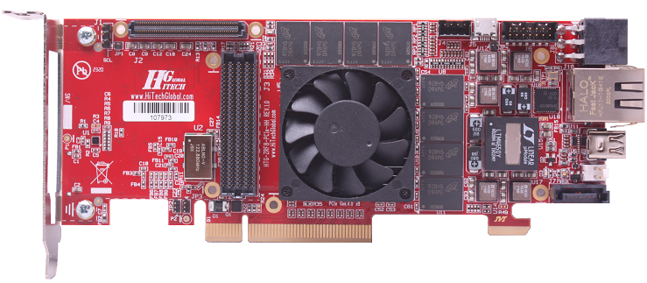
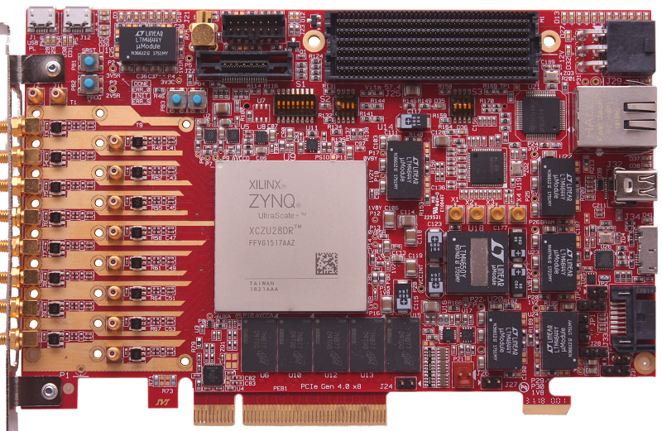
Power for Xilinx Zynq UltraScale+ RFSoC Page 1 of 2
 | Need Higher Power? | Need Lower Power?
LTM4650 | LTM4678, LTM4680 LTM4700, LTM4681 (all with PMBus) | LTM4630, LTM4636 LTM4677 (PMBus)
LTM4638 | LTM4645, LTM4620, LTM4630 | LTM4626, LTM4657, LTM4705
Xilinx ZYNQ UltraScale+ RFSoC ZU28DR or ZU48DR
 | Need Higher Power? | Need Lower Power?
LTM4650 | LTM4678, LTM4680 LTM4700, LTM4681 (all with PMBus) | LTM4630, LTM4636 LTM4677 (PMBus)
LTM4644 | LTM4671 | LTM4643, LTM4668
Xilinx ZYNQ UltraScale+ RFSoC ZU28DR or ZU48DR

Slide 24
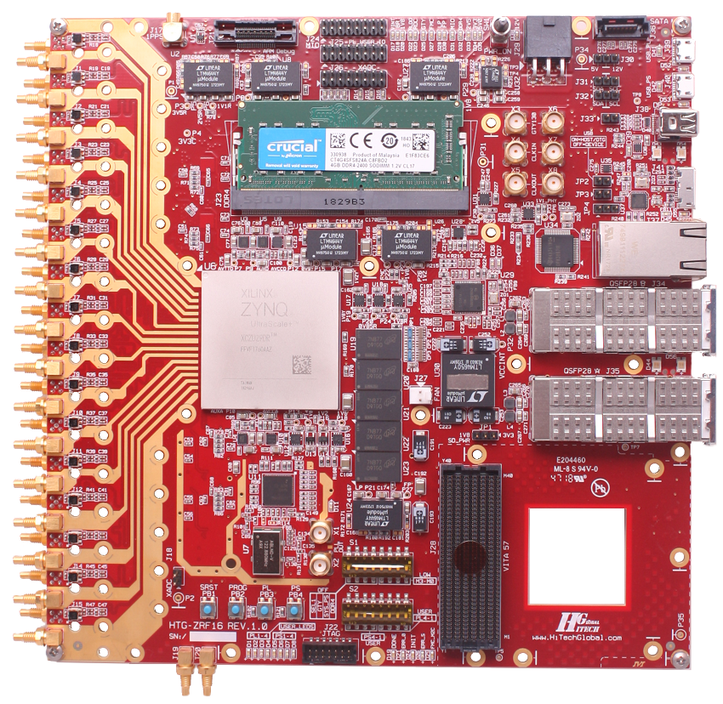
Power for Xilinx Zynq UltraScale+ RFSoC Page 2 of 2
 | Need Higher Power? | Need Lower Power?
LTM4650 | LTM4678, LTM4680 LTM4700, LTM4681 (all with PMBus) | LTM4630, LTM4636 LTM4677 (PMBus)
LTM4644 | LTM4671 | LTM4643, LTM4668
LTM4625 | LTM4657, LTM4626, LTM4638, LTM4705 | LTM4623, LTM4624, LTM4622
Xilinx ZYNQ UltraScale+ RFSoC ZU29DR or ZU49DR

Slide 25
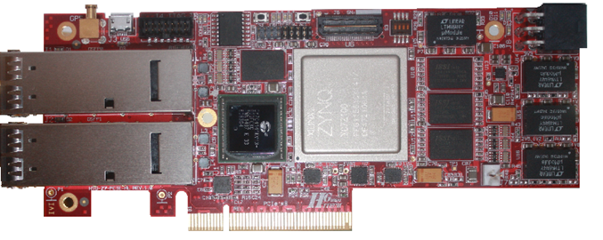
Power for Xilinx Zynq 7
 | Need Higher Power? | Need Lower Power?
LTM4644 | LTM4671 | LTM4643, LTM4668
Reference design:
Xilinx Zynq XC7Z100
ADI Website
HiTechGlobal Website:
http://www.hitechglobal.com/index.htm

Slide 26
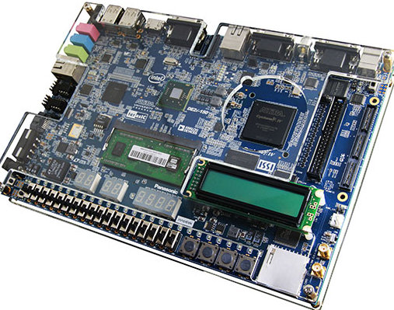
Power for Intel (Altera) Cyclone IV
 | Need Higher Power? | Need Lower Power?
LTM4628 | LTM4631, LTM4620, LTM4630, LTM4650 | LTM4705, LTM4642
Altera Cyclone IV GX
Reference design:
Terasic Website
ADI Website

Slide 27
Power for Intel (Altera) Cyclone V
 | Need Higher Power? | Need Lower Power?
LTM4644 | LTM4671 | LTM4643
Altera Cyclone V GT
Reference design:
ADI Website
ReflexCES Website

Slide 28
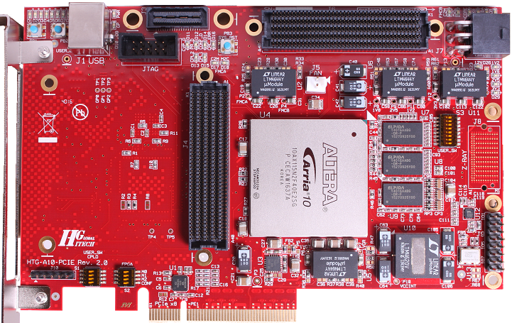
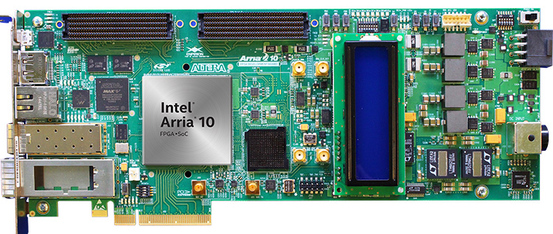
Power for Intel (Altera) Arria 10 Page 1 of 5
 | Need Higher Power? | Need Lower Power?
LTM4644 | LTM4671 | LTM4643
LTM4620 | LTM4662, LTM4630, LTM4650 | LTM4631, LTM4628, LTM4646
Altera Arria 10 GX570, GX660, GX900, GX1150, SX570, or SX660
 | Need Higher Power? | Need Lower Power?
LTM4620 | LTM4662, LTM4630, LTM4650 | LTM4631, LTM4628, LTM4646
LTM4637 | LTM4620, LTM4676, LTM4662, LTM4630, LTM4650 | LTM4675, LTM4638
LTM4622 | LTM4618, LTM4657, LTM4626 | LTM4622A, LTM4624, LTM4623
Reference design:
Terasic Website
HiTechGlobal Website: http://www.hitechglobal.com/index.htm
Altera Arria 10 GX
ADI Website

Slide 29
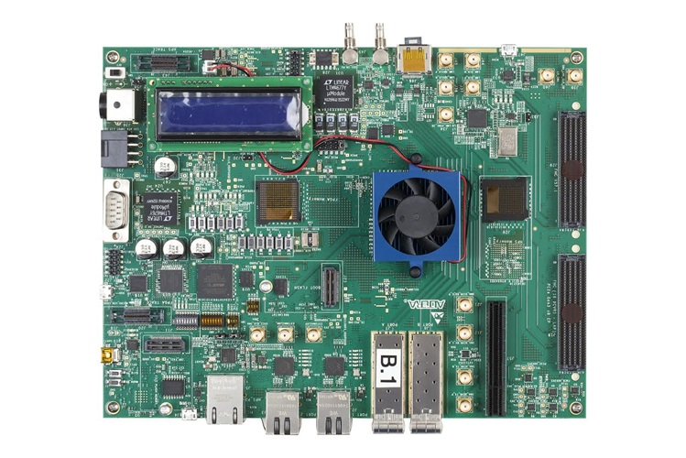
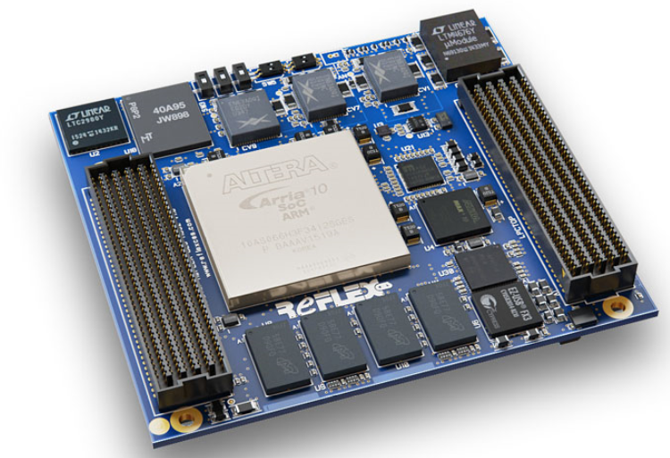
Power for Intel (Altera) Arria 10 Page 2 of 5
 | Need Higher Power? | Need Lower Power?
LTM4677 | LTM4678, LTM4680, LTM4700, LTM4681 | LTM4676, LTM4686
LTM4676 | LTM4677, LTM4678, LTM4680, LTM4700, LTM4681 | LTM4686, LTM4675
Altera Arria 10 SoC
Reference design:
Terasic Website
ADI Website
Altera Arria 10 SoC

Slide 30
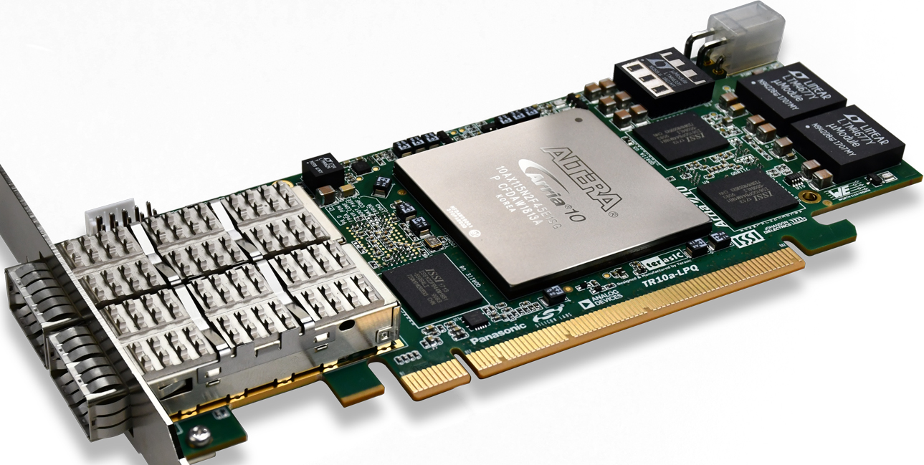
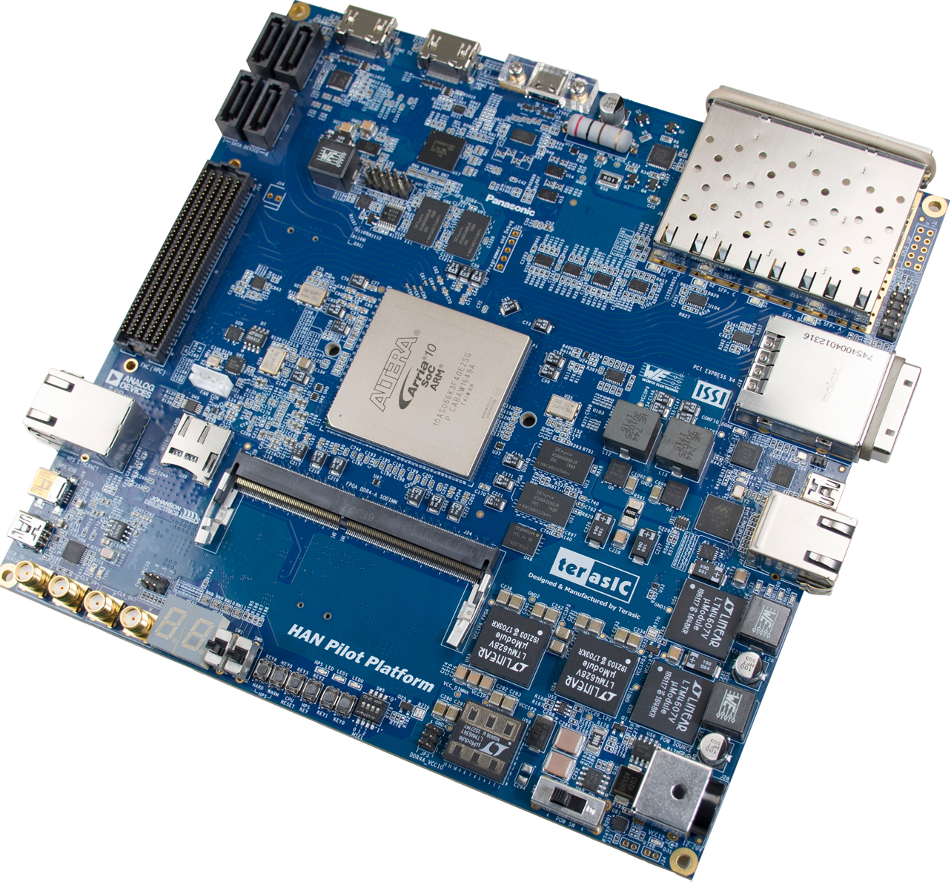
Power for Intel (Altera) Arria 10 Page 3 of 5
 | Need Higher Power? | Need Lower Power?
LTM4677 | LTM4678, LTM4680, LTM4700 LTM4681 | LTM4676, LTM4686
LTM4633 | LTM4634, LTM4671 | LTM4643
 | Need Higher Power? | Need Lower Power?
LTM4607 | LTM4605 | LTM8055, LTM8054
LTM4628 | LTM4631, LTM4620, LTM4630, LTM4650 | LTM4705, LTM4642
LTM4634 | LTM4671 | LTM4633
Reference design:
Terasic Website
ADI Website

Slide 31
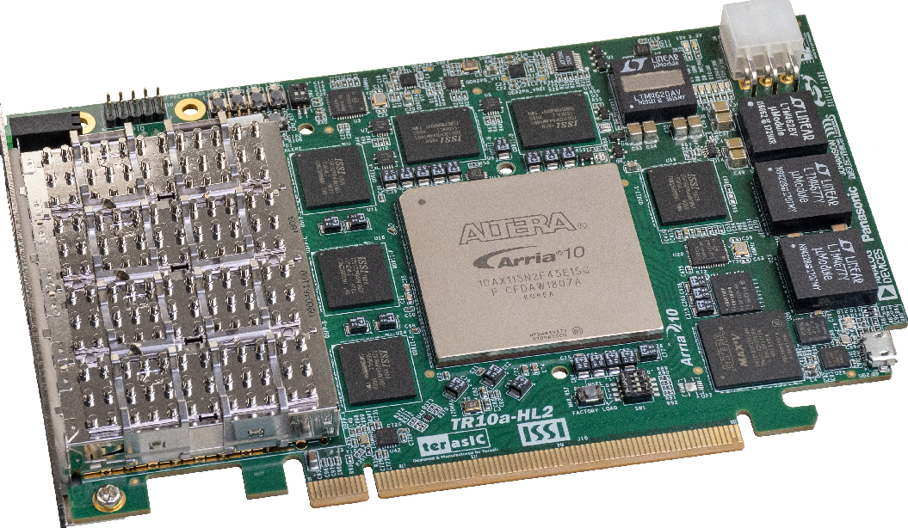
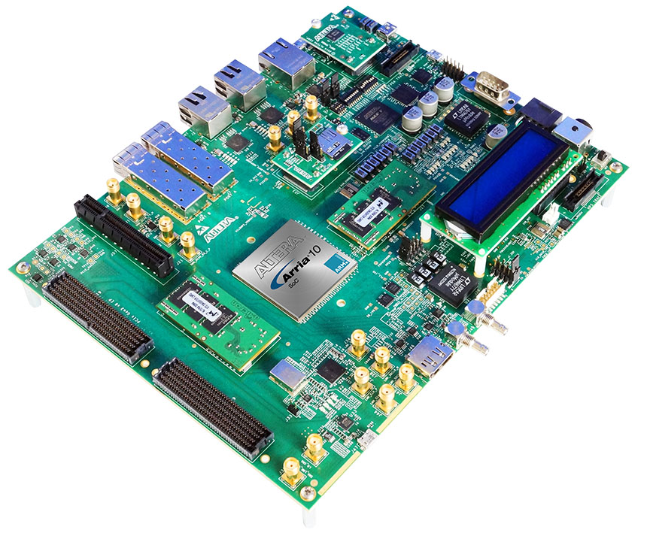
Power for Intel (Altera) Arria 10 Page 4 of 5
 | Need Higher Power? | Need Lower Power?
LTM4620 | LTM4662, LTM4630, LTM4650 | LTM4631, LTM4628, LTM4646
LTM4628 | LTM4631, LTM4620, LTM4630, LTM4650 | LTM4705, LTM4642
LTM4677 | LTM4678, LTM4680, LTM4700 LTM4681 | LTM4676, LTM4686
Reference design:
Terasic Website
ADI Website

Slide 32
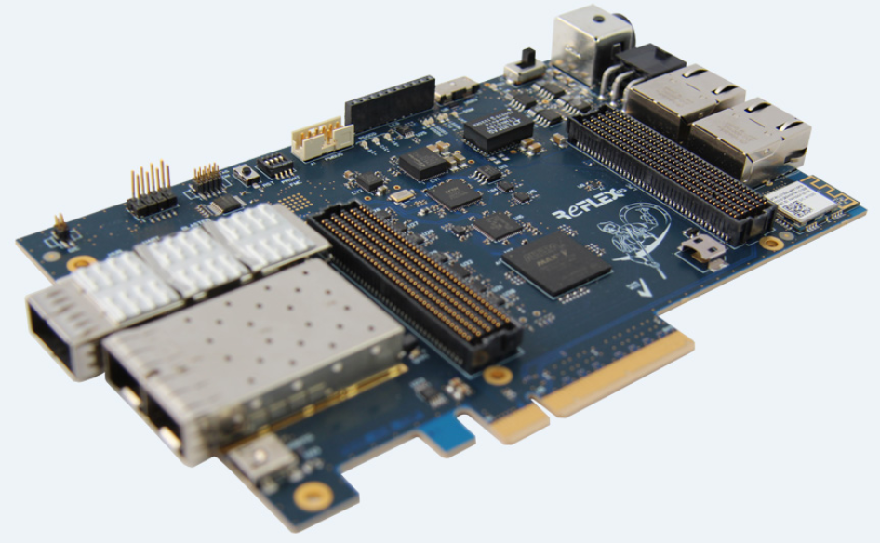
Power for Intel (Altera) Arria 10 Page 5 of 5
 | Need Higher Power? | Need Lower Power?
LTM4644 | LTM4671 | LTM4643
Reference design:
ReflexCES Website

Slide 33
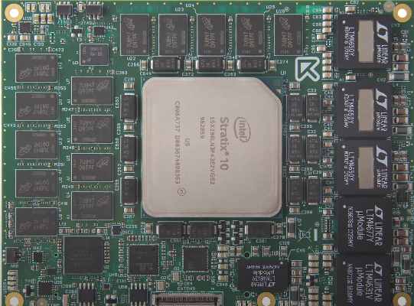
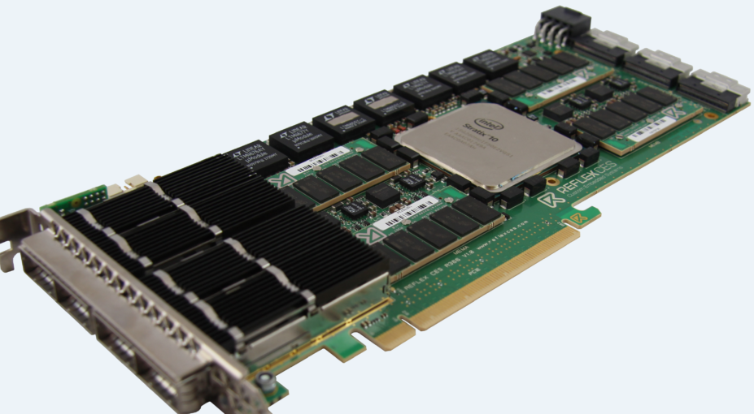
Power for Intel (Altera) Stratix 10 Page 1 of 2
 | Need Higher Power? | Need Lower Power?
LTM4650 | LTM4678, LTM4680 LTM4700, LTM4681 | LTM4630, LTM4677 LTM4662, LTM4636, LTM4647
LTM4677 | LTM4678, LTM4680, LTM4700 LTM4681 | LTM4676, LTM4686
LTM4631 | LTM4620, LTM4676A, LTM4662 | LTM4628
LTM4643 | LTM4644 | LTM4632, LTM4668, LTM4625, LTM4624

Slide 34
Power for Intel (Altera) Stratix 10 Page 2 of 2
 | Need Higher Power? | Need Lower Power?
LTM4650 | LTM4678, LTM4680 LTM4700, LTM4681 | LTM4630, LTM4677 LTM4662, LTM4636, LTM4647
LTM4677 | LTM4678, LTM4680, LTM4700, LTM4681 | LTM4676, LTM4686
LTM4631 | LTM4620, LTM4676A, LTM4662 | LTM4628
LTM4636 | LTM4650, LTM4678, LTM4680, LTM4700, LTM4681 | LTM4647, LTM4630, LTM4662, LTM4620

Slide 35
Enpirion vs µModule Regulators Cross Reference (Page 1 of 2)
4A to 12A
I_{OUT} Max | Enpirion PN | V_{IN} | V_{OUT} | Replace with µModule PN |  | Why
 |  |  |  | Single Output | Dual Output | Quad Output
4A | EN6340QI | 2.7V - 6.6V | 0.6V - V_{IN} | LTM4668 (Quad 1.2A, 1.8V_{OUT}) LTM4668A (Quad 1.2A, 5.5V_{OUT}) LTM4625 (5A) LTM4622 (Dual 2.5A or Single 5A) LTM4622A (Dual 2A or Single 4A) | LTM4705 (Dual 5A or Single 10A) | LTM4644 (Quad 4A)
 | EN6347QI | 2.5V - 6.6V | 0.75V - V_{IN}
20A | EN2342QI | 4.5V - 14V | 0.75V - 5V
 | EN2340QI | 4.5V - 14V | 0.75V - 5V
6A | EN5364QI | 2.4V - 6.6V | 0.6V - V_{IN} | LTM4657 (8A) | LTM4643 (Quad 3A) LTM4644 (Quad 4A) | -
 | EN5367QI | 2.5V - 5.5V | 0.75V - V_{IN}
 | EN6362QI | 3V - 6.5V | 0.6V - V_{IN}
 | EN6363QI | 2.7V - 6.6V | 0.75V - V_{IN}
8A | EN6382QI | 3V - 6.5V | 0.6V - V_{IN} | LTM4657 (8A) | LTM4644 (Quad 4A) | -
 | EN6360QI | 2.5V - 6.6V | 0.6V - V_{IN}
9A | EN5394QI | 2.4V - 6.6V | 0.6V - V_{IN} | LTM4626 (12A) | LTM4675 (Dual 9A or Single 18A) LTM4646 (Dual 10A or Single 20A) LTM4620 (Dual 13A or Single 26A) LTM4662 (Dual 15A or Single 30A) | -
10A | EN29A0QI | 9V - 16V | 0.75V - 3.3V
12A | EN63A0QI | 2.5V - 6.6V | 0.6V - V_{IN}

Slide 36
Enpirion vs µModule Regulators Cross Reference (Page 2 of 2)
20A to 80A
I_{OUT} Max | Enpirion PN | PMBus | V_{OUT} | Replace with µModule PN |  | Why
 |  |  |  | Single Output | Dual Output | Quad Output
20A | EM2120L | Yes | 0.7V – 1.325V | LTM4675 (Dual 9A or Single 18A) LTM4686 (Dual 10A or Single 20A) LTM4686-1 LTM4676A (Dual13A or Single 26A) | LTM4678 (Dual 25A or Single 50A) | LTM4681 (Quad 31.25A)
20A | EM2120H | Yes | 1.35V – 5V
30A | EM2130L | Yes | 0.7V – 1.325V | LTM4677 (Dual 18A or Single 36A) | LTM4680 (Dual 30A or Single 60A) | LTM4681 (Quad 31.25A)
 | EM2130H |  | 1.35V – 3.6V
30A | EM2030L | No | 0.5V – 1.325V | LTM4647 (30A) LTM4662 (Dual 15A or Single 30A) LTM4630 (Dual 18A or Single 36A) | LTM4680 (Dual 30A or Single 60A) | LTM4681 (Quad 31.25A)
40A | EM2140 | Yes | 0.5V – 1.325V | LTM4678 (Dual 25A or Single 50A) | LTM4700 (Dual 50A or Single 100A) | -
40A | EM2040 | No | 0.5V – 1.325V | LTM4636 (40A) LTM4650 (Dual 25A or Single 50A) | LTM4700 (Dual 50A or Single 100A) | -
60A | EM2260 | Yes | 0.5V – 1.3V | LTM4680 (Dual 30A or Single 60A) | LTM4681 (Quad 31.25A, Dual 62.5A or Single 125A) | -
80A | EM2280 | Yes | 0.5V – 1.3V | LTM4700 (Dual 50A or Single 100A) | - | -
Ultrathin
Low V_{IN}

Slide 37
Power for AFE: Ultralow Noise, Buck-Boost & Boost
# of Output | V_{IN} | V_{OUT} | I_{OUT} | EMI Standard | Package (mm) | Part #
1 | 3.2V to 40V | 0.8V to 12V | 1.2A | CISPR22 Class B | 4 x 4 x 1.82 (BGA) | LTM8074
 | 3.2V to 40V | 0.8V to 15V | 2A | CISPR22 Class B | 4 x 6.25 x 2.22 (BGA) | LTM8063
 | 3.4V to 40V | 0.97V to 18V | 2.5A | CISPR22 Class B | 6.25 x 6.25 x 2.32 (BGA) | LTM8065
 | 3.4 to 40V | 0.97V to 15V | 3.5A | CISPR22 Class B | 6.25 x 9 x 3.32 (BGA) | LTM8053
2 | 3V to 40V | 0.8V to 10V | Dual 1.4A | CISPR22 Class B | 6.25 x 6.25 x 2.22 (BGA) | LTM8078
 | 3.6V to 20V | 0.8V to 8V | Dual 3.5A |  | 9 x 11.25 x 3.32 (BGA) | LTM8024
4 | 3V to 40V | 0.8 to 8V | Quad 1.2A | CISPR22 CLASS B CISPR 25 CLASS 5 | 6.25 x 11.25 x 2.22 (BGA) | LTM8051
 |  |  | Quad 3A |  | 11.9 x 16 x 3.32 (BGA) | LTM8060
Low EMI µModule Regulators
Buck-Boost & Boost µModule Regulators
Power for FPGA, DSP
# of Output | V_{IN} | V_{OUT} | I_{OUT} | SYNC Range | Package (mm) | Part #
1 | 2.375V to 20V | 0.6V to 5.5V | 3A | 700kHz to 1.3MHz | 6.25 x 6.25 x 1.82 (LGA) x 2.42 (BGA) | LTM4623
2 | 3.6V to 20V | 0.6V to 5.5V | Dual 2.5A | 560kHz to 4MHz | 6.25 x 6.25 x 1.82 (LGA) x 2.42 (BGA) | LTM4622
 | 3.1V to 20V |  | Dual 5A | 700kHz to 3MHz | 6.25 x 7.5 x 3.22 (BGA) | LTM4705
 | 2.375V to 20V | 0.6V to 5.5V | Dual 10A | 250kHz to 1.3MHz | 11.25 x 15 x 5.01 (BGA) | LTM4646
 | 2.375V to 20V | 0.6V to 5.5V | Dual 15A | 250kHz to 1MHz | 11.25 x 15 x 5.74 (BGA) | LTM4662
4 | 2.375V to 14V | 0.6V to 5.5V | Quad 4A | 700kHz to 1.3Mhz | 9 x 15 x 5.01 (BGA) | LTM4644
More power solutions for Xilinx & Intel FPGAs
µModule Regulators with PMBus Interface

Slide 38
FPGA Reference Designs
Supplier Verified Reference Designs
16nm UltraScale+ | 20nm UltraScale | 28nm 7-Series
Virtex UltraScale+ | Virtex UltraScale | Virtex 7
 | Kintex UltraScale | Kintex 7
Versal Series | Zynq
AI Core | UltraScale+ MPSoC
Prime | UltraScale+ RFSoC
 | Zynq-7000 SoC
MAX | Cyclone | Arria | Stratix
MAX 10 (2014, 55 nm) | Cyclone 10 (2017) | Arria 10 (2013, 20nm) | Stratix 10 (2013, 14nm)
 | Cyclone V (2011) | Arria V (2012, 28nm) | Stratix V (2010, 28nm)
 | Cyclone IV (2009) |  | Stratix IV (2008, 40nm)
Click here for Cross Reference to Enpirion Modules

Slide 39
Step-Down (Buck) Ultralow Noise
Function | # of Output | Input Voltage (V) |  | Output Voltage (V) |  | Output Current (A) | EMI Standard | Silent Switcher® Architecture | Package |  |  | Part Number
 |  | Min | Max | Min | Max |  |  |  | Dimensions (mm) | Height (mm) | Package
Step-Down | 1 | 4 | 36 | 1.25 | 5 | 0.2A | EN55022 Class B | - | 6.25 x 6.25 | 2.32 | LGA | LTM8020
 |  | 3 | 36 | 0.8 | 5 | 0.5A | CISPR22 Class B | - | 6.25 x 11.25 | 2.82 | LGA | LTM8021
 |  | 3.6 | 36 | 0.8 | 10 | 1A | EN55022 Class B | - | 9 x 15 | 2.82 | LGA | LTM8031
 |  | 3.2 | 40 | 0.8 | 12 | 1.2A | CISPR22 Class B | Yes | 4 x 4 | 1.82 | BGA | LTM8074
 |  | 3.6 | 36 | 0.8 | 10 | 2A | EN55022 Class B | - | 9 x 15 | 2.82 3.42 | LGA BGA | LTM8032
 |  | 3.2 | 40 | 0.8 | 15 | 2A | CISPR22 Class B | Yes | 4 x 6.25 | 2.22 | BGA | LTM8063
 |  | 3.4 | 40 | 0.97 | 18 | 2.5A | CISPR22 Class B | Yes | 6.25 x 6.25 | 2.32 | BGA | LTM8065
 |  | 3.4 | 40 | 0.97 | 18 | 2.8A | CISPR25 Class 5 | Yes | 6.25 x 6.25 | 2.22 | BGA | LTM8002
 |  | 3.6 | 36 | 0.8 | 24 | 3A | EN55022 Class B | - | 11.25 x 15 | 4.32 4.92 | LGA BGA | LTM8033
 |  | 4 2.375 with External Bias | 20 | 0.6 | 5.5 | 3A | EN55022 Class B | - | 6.25 x 6.25 | 1.82 2.42 | LGA BGA | LTM4623
 |  | 3.4 | 60 | 0.8 | 15 | 3A | CISPR22 Class B | Yes | 6.25 x 9 | 3.32 | BGA | LTM8073
 |  | 3.4 | 40 | 0.97 | 15 | 3.5A | CISPR22 Class B | Yes | 6.25 x 9 | 3.32 | BGA | LTM8053 / LTM8053-1
 |  | 3.4 | 40 | 0.97 | 18 | 3.5A | CISPR25 Class 5 | Yes | 6.25 x 9 | 3.32 | BGA | LTM8003
 |  | 3.1 | 58 | 0.5 | 0.94*Vin | 4A | EN55022 Class B | - | 9 x 15 | 5.01 | BGA | LTM4653
 |  | 3.6 | 60 | 0.97 | 15 | 5A | CISPR22 Class B | Yes | 9 x 11.25 | 3.32 | BGA | LTM8071
 |  | 5 | 36 | 3.3 | 15 | 5A | EN55022 Class B | - | 15 x 15 | 2.8 | LGA | LTM4612
 |  | 4.5 | 28 | 0.6 | 5 | 6A | EN55022 Class B | - | 15 x 15 | 2.82 3.42 | LGA BGA | LTM4606
 |  | 5 | 36 | 3.3 | 15 | 8A | EN55022 Class B | - | 15 x 15 | 4.32 4.92 | LGA BGA | LTM4613
 | 2 | 3 | 40 | 0.8 | 10 | Dual 1.4A or Single 2.8A | CISPR22 Class B | Yes | 6.25 x 6.25 | 2.22 | BGA | LTM8078
 |  | 3 | 40 | 0.8 | 8 | Dual 3.5A or Single 7A | CISPR22 Class B | Yes | 9 x 11.25 | 3.32 | BGA | LTM8024
 | 4 | 3 | 40 | 0.8 | 8 | Quad 1.2A | CISPR22 Class B CISPR25 Class 5 | Yes | 6.25 x 11.25 | 2.22 | BGA | LTM8051
 |  | 3 | 40 | 0.8 | 8 | Quad 3A |  | Yes | 11.9 x 16 | 3.32 | BGA | LTM8060
µModule Regulators
Show me Ultrathin
Show me
New Products
(2019,20,21)
Show me
Pin-Compatible
Show me
Silent Switcher

Slide 40
Step-Down (Buck) Digital PSM
µModule Regulators
Function | # of Output | Input Voltage (V) |  | Output Voltage (V) |  | Output Current (A) | Read Back Accuracy |  | Turn-On | Package |  |  | Part Number
 |  | Min | Max | Min | Max |  | Voltage | Current | Time (ms) | Dimensions (mm) | Height (mm) | Package
Step-Down | 2 | 4.5 | 17 | 0.5 | 5.5 | Dual 9A or Single 18A | ±0.5% | ±2.5% | 40 | 11.9 x 16 | 3.51 | BGA | LTM4675
 |  | 4.5 | 17 | 0.5 | 3.6 | Dual 10A or Single 20A | ±0.5% | ±5% | 39 | 11.9 x 16 | 1.82 | LGA | LTM4686
 |  | 2.375 | 17 | 0.5 | 3.6 | Dual 10A or Single 20A | ±0.5% | ±5% | 39 | 11.9 x 16 | 1.82 | LGA | LTM4686-1
 |  | 4.5 | 26.5 | 0.5 | 5.5 | Dual 13A or Single 26A | ±0.5% | ±2.5% | 40 | 16 x 16 | 5.01 | BGA | LTM4676A
 |  | 4.5 | 16 | 0.5 | 1.8 | Dual 18A or Single 36A | ±0.5% | ±2.5% | 40 | 16 x 16 | 5.01 | BGA | LTM4677
 |  | 4.5 | 16 | 0.5 | 3.4 | Dual 25A or Single 50A | ±0.5% | ±3.5% | 30 | 16 x 16 | 5.86 | BGA | LTM4678
 |  | 30 | 58 | 0.5 | 1.5 | Dual 25A or Single 50A | ±0.5% | ±3% | 40 | 16 x 16 | 7.72 | BGA | LTM4664
 |  | 4.5 | 16 | 0.5 | 3.3 | Dual 30A or Single 60A | ±0.5% | ±2.5% | 30 | 16 x 16 | 7.82 | BGA | LTM4680
 |  | 4.5 | 16 | 0.5 | 1.8 | Dual 50A or Single 100A | ±0.5% | ±3% | 30 | 15 x 22 | 7.87 | BGA | LTM4700
 | 4 | 4.5 | 16 | 0.5 | 3.3 | Configurable Quad 31.25A or Single 125A | ±0.5% | ±4% | 30 | 15 x 22 | 8.17 | BGA | LTM4681
Show me Ultrathin
Show me
High Vin
Show me
New Products
(2018,19,20)
Show me
Pin-Compatible

Slide 41
Step-Up (Boost)
Function | Input Voltage (V) |  | Output Voltage (V) |  | # of Output | Switch Current | Package |  |  |  | Release Year
 | Min | Max | Min | Max |  |  | Dimensions (mm) | Height (mm) | Package | Part Number
Step-Up | 1.8 down to 0.7V after start-up | 5.5 | 2.5 | 15 | 1 | 4A | 6.25 x 6.25 | 2.42 | BGA | LTM4661 | 2017
 | 5 | 38 | 2 | 40 | 1 | 10A | 9 x 11.25 | 2.22 | BGA | LTM8005 | 2018
 | 4.5 | 28 | 6 | 36 | 1 | 4A | 16 x 16 | 7.07 | BGA | LTM4656/-1 | 2020
µModule Regulators
Show me
Pin-Compatible
Step-Up & Down (Buck-Boost)
Number of Output | Topology | Input Voltage (V) |  | Output Voltage (V) |  | Output Current (A) | Inductor | Package |  |  | Part Number | Release Year
 |  | Min | Max | Min | Max |  |  | Dimensions (mm) | Height (mm) | Package
1 | SEPIC or Inverting | 2.8 | 18 | ±2.5 | ±15 | Up to 0.7A † | Internal | 6.25 x 11.25 | 4.92 | BGA | LTM8045 | 2013
 | 4-Switch Buck-Boost | 3 | 36 | 1 | 36 | 1.5A | Internal | 6.25 x 6.25 | 2.22 | BGA | LTM8083 | 2020
 |  | 5 | 36 | 1.2 | 36 | 5.4A† | Internal | 11.25 x 15 | 3.42 | BGA | LTM8054 | 2015
 |  | 5 | 58 | 1.2 | 48 | 5.4A† | Internal | 15 x 15 | 4.92 | BGA | LTM8056 | 2015
 |  | 5 | 36 | 1.2 | 36 | 8.5A† | Internal | 15 x 15 | 4.92 | BGA | LTM8055/LTM8055-1 | 2015
 |  | 4.5 | 36 | 0.8 | 24 | 10A† | External | 15 x 15 | 2.8 | LGA | LTM4607 | 2007
 |  | 4.5 | 36 | 0.8 | 34 | 10A† | External | 15 x 15 | 2.82 3.42 | LGA BGA | LTM4609 | 2009
 |  | 4.5 | 20 | 0.8 | 16 | 12A† | External | 15 x 15 | 2.8 | LGA | LTM4605 | 2007
2 | SEPIC or Inverting | 2.6 | 20 | ±2.5 | ±24 | Up to 1A† | Internal | 9 x 15 | 2.42 | BGA | LTM8049 | 2016
†Step-Down Mode. Output current varies depending on operation mode.

Slide 42
µModule Regulators for Automotive Applications
µModule regulator with AEC-Q104 Qualification (Jan 2022):
LTM8078#3PP (Dual 1.4A, Single 2.8A Step-Down Silent Switcher μModule Regulator)
µModule regulators with AEC-Q200 internal components:
LTM8024 (40V_{IN}, Dual 3.5A or Single 7A Silent Switcher μModule Regulator)
LTM8002 (40V_{IN}, 2.5A Silent Switcher μModule Regulator)
LTM8003 (40V_{IN}, 3.5A Step-Down Silent Switcher μModule Regulator)
If you have a new proposal for automotive-grade µModule regulator, contact us.

Slide 43
µModule Regulators for Aerospace & Defense
# of Output | Input Voltage (V) |  | Output Voltage (V) |  | Operating Temp (°C) | Output Current (A) | Package |  |  |  | Part Number
 | Min | Max | Min | Max |  |  | Dimensions (mm) | Height (mm) | Package | SnPb (Tin-Lead)?
1 | 4 | 36 | 1.25 | 5 | -55°C to 125°C | 0.2A | 6.25 × 6.25 | 2.32 | LGA | - | LTM8020MP
 | 4.5 | 36 | 1.2 | 18 |  | 0.6A | 6.25 × 11.25 | 3.42 | BGA | Yes | LTM8029MP
 | 3.6 | 36 | 0.8 | 10 |  | 1A | 9 × 11.25 | 2.82 | LGA | - | LTM8022MP
 |  |  |  |  |  | 1A | 9 × 15 |  |  |  | LTM8031MP
 | 3.6 | 36 | 0.8 | 10 |  | 2A | 9 x 11.25 | 2.82 3.42 | LGA BGA | Yes | LTM8023MP
 |  |  |  |  |  | 2A | 9 x 15 |  |  |  | LTM8032MP
 | 3.6 | 36 | 0.8 | 24 |  | 3A | 9 x 15 | 4.32 4.92 | LGA BGA | Yes | LTM8025MP
 | 3.6 | 58 | 0.8 | 24 |  | 2A | 9 x 15 | 4.92 | BGA | Yes | LTM8050MP
 | 3.6 | 36 | 0.8 | 24 |  | 3A | 11.25 × 15 | 4.32 4.92 | LGA BGA | Yes | LTM8033MP
 | 4.5 | 60 | 2.5 | 24 |  | 4A | 15 × 15 |  |  |  | LTM8027MP
 | 6 | 36 | 1.2 | 24 |  | 5A | 11.25 × 15 | 2.82 3.42 | LGA BGA | Yes | LTM8026MP
 | 6 |  | 0.8 | 1.8 |  | 5A | 15 × 15 | 4.92 | BGA | Yes | LTM8028MP
 | 5 |  | 3.3 | 15 |  | 5A |  | 2.8 | LGA | - | LTM4612MP
 | 6 |  | 1.2 | 24 |  | ±5A | 11.25 x 15 | 2.82 3.42 | LGA BGA | Yes | LTM8052MP
 | 4.5 | 28 | 0.6 | 5 |  | 6A | 15 × 15 | 2.82 3.42 | LGA BGA | Yes | LTM4606MP
 | 2.7 | 5.5 | 0.6 | 5 |  | 8A | 9 × 15 |  |  |  | LTM4608AMP
 | 5 | 36 | 3.3 | 15 |  | 8A | 15 × 15 | 4.32 | LGA | - | LTM4613MP
 | 4.5 | 28 | 0.6 | 5 |  | 10A |  | 2.82 | LGA | - | LTM4600HVMP
 | 4.5 | 38 | 0.6 | 6 |  | 10A |  | 5.01 | BGA | Yes | LTM4641MP
 | 4.5 | 28 | 0.6 | 5 |  | 12A |  | 2.82 3.42 | LGA BGA | Yes | LTM4601AHVMP
 | 4.5 | 20 |  |  |  | 15A |  | 4.92 | BGA | Yes | LTM4627MP
2 | 2.7 | 5.5 |  |  |  | Dual 8A or Single 16A |  | 2.82 3.42 | LGA BGA | Yes | LTM4616MP
 | 4.5 | 16 | 0.6 | 2.5 5.3 |  | Dual 13A or Single 26A |  | 5.01 | BGA | Yes | LTM4620MP LTM4620AMP
 | 4.5 | 15 | 0.6 | 1.8 |  | Dual 25A or Single 50A | 16 x 16 | 5.01 | BGA | Yes | LTM4650MP
3 | 2.375 | 16 | 0.8 | 1.8, 5.5 |  | Triple 10A | 15 × 15 | 5.01 | BGA | Yes | LTM4633MP
4 | 2.375 | 20 | 0.6 | 3.3 |  | Quad 3A, up to 12A | 9 x 15 | 1.82 2.42 | LGA BGA | Yes | LTM4643MP
 |  | 14 | 0.6 | 5.5 |  | Quad 4A, up to 16A |  | 5.01 | BGA | Yes | LTM4644MP
6 | 6 | 36 | 1.2 | 24 |  | Five 1.1A Parallelable | 15 × 15 | 3.42 | BGA | Yes | LTM8001MP

Slide 44
System Power
FPGA or DSP
Reference Designs for Xilinx & Intel FPGAs
POL PMBus
Low EMI µModule Regulators
Core Power
Buck-Boost & Boost µModule Regulators
Pin-Compatible

Slide 45
Step-Down (Buck) Quad Configurable Output
µModule Regulators
# of Output | Input Voltage (V) |  | Output Voltage (V) |  | Output Current (A) | Parallelable Outputs | Package |  |  | Part Number
 | Min | Max | Min | Max |  |  | Dimensions (mm) | Height (mm) | Package
4 | 2.7 | 17 | 0.6 | 1.8 | Quad: 1.2A | * | 6.25 x 6.25 | 2.1 | BGA | LTM4668
 | 2.7 | 17 | 0.6 | 5.5 | Quad: 1.2A | * | 6.25 x 6.25 | 2.1 | BGA | LTM4668A
 | 3 | 40 | 0.8 | 8 | Quad: 1.2A | Yes | 6.25 x 11.25 | 2.22 | BGA | LTM8051
 | 3 | 40 | 0.8 | 8 | Quad 3A | Yes | 11.9 x 16 | 3.32 | BGA | LTM8060
 | 4 2.375 with External Bias | 20 | 0.6 | 3.3 | Quad: 3A | x1 (12A) | 9 x 15 | 1.82 2.42 | LGA BGA | LTM4643
 | 4 2.375 with External Bias | 14 | 0.6 | 5.5 | Quad: 4A | x1 (16A) | 9 x 15 | 5.01 | BGA | LTM4644 / LTM4644-1
 | 3.1 | 20 | 0.6 | 3.3V (for 12A Output) 5.5V (for 5A Output) | Quad: 5A, 5A, 12A, 12A | - | 9.5 x 16 | 4.72 | BGA | LTM4671
 | 4.5 | 16 | 0.5 | 3.3 | Quad 31.25A | Yes | 15 x 22 | 8.17 | BGA | LTM4681
Show me Ultrathin
Show me
Silent Switcher
Show me
Pin-Compatible
Show me
New Products
(2019,20,21)

