Slide 1
Search by µModule Regulator Package (click on green boxes) (For simplicity, illustrations depict both BGA and LGA packages)
9 x 11.25mm
9 x 15mm
Top Side PCB
LTM8080 added!
6.25 x 6.25mm
6.25 x 9mm
11.25 x 15mm
15 x 15mm
LTM4683 added!
3 x 4mm
4 x 4mm
6.25 x 6.25mm CoP
6.25 x 11.25mm
11.9 x 16mm
16 x 16mm
16 x 16mm CoP
15 x 22mm CoP
10.34mm (tallest)
LTM4702 added!
LTM4710-1 added!
LTM4686B added!
7.87mm
≤1.3mm
2.8mm
1.18mm
1.8mm
<2mm
Bottom Side PCB

Slide 2
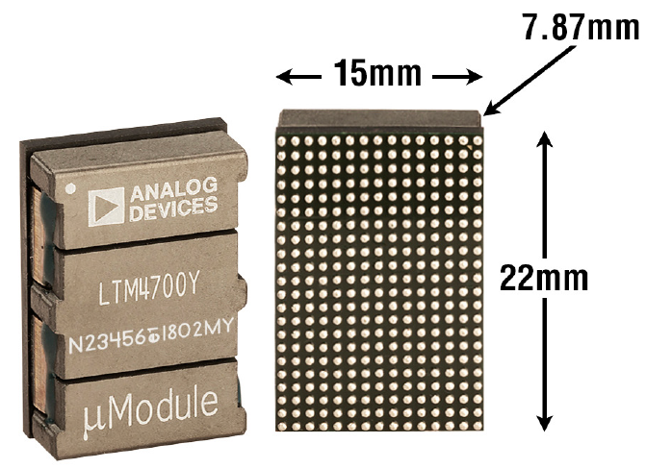
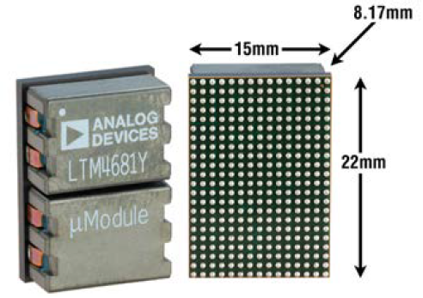
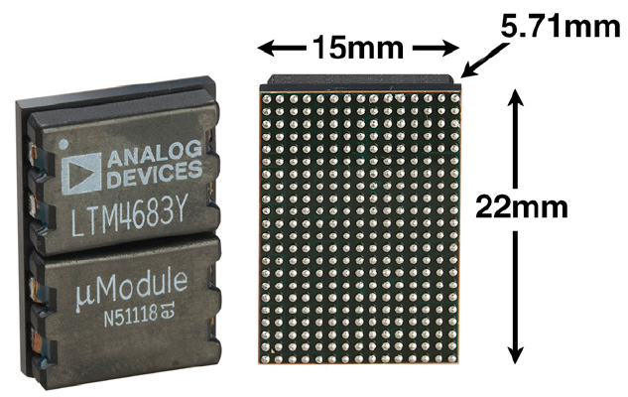
15 x 22mm CoP µModule Regulators
µModule Regulators
Function | # of Output | Input Voltage (V) |  | Output Voltage (V) |  | Output Current (A) | Package |  |  | Part Number
 |  | Min | Max | Min | Max |  | Dimensions (mm) | Height (mm) | Package
Buck | 2 | 4.5 | 16 | 0.5 | 1.8 | Dual 50A or Single 100A | 15 x 22 | 7.87 | BGA | LTM4700
 | 4 | 4.5 | 16 | 0.5 | 3.3 | Quad 31.25 or Single 125A | 15 x 22 | 8.17 | BGA | LTM4681
 |  | 4.5 | 14 | 0.3 | 0.7 | Quad 31.25 or Single 125A |  | 5.71 | BGA | LTM4683
Show me PMBus
Show me
Pin-Compatible
Show me
New Products
(2021,22,23)

Slide 3
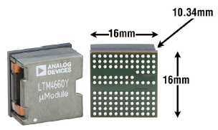
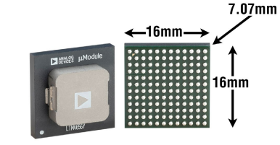
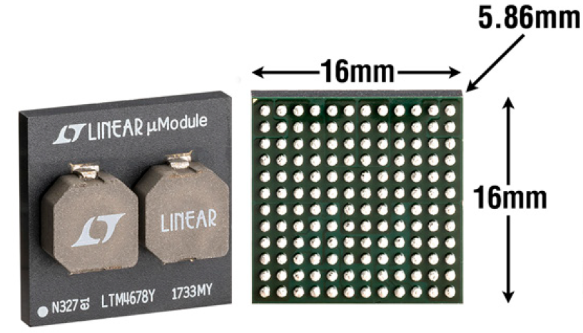
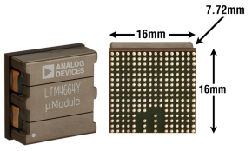
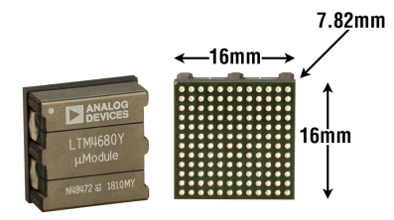
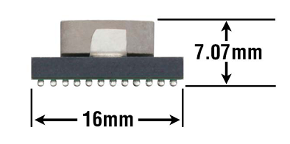
16 x 16mm CoP µModule Regulators
µModule Regulators
Function | # of Output | Input Voltage (V) |  | Output Voltage (V) |  | Output Current (A) | Package |  |  | Part Number
 |  | Min | Max | Min | Max |  | Dimensions (mm) | Height (mm) | Package
Buck | 1 | 30 | 60 | 4.5 | 18 | 25A, up to 300W | 16 x 16 | 10.34 | BGA | LTM4660
Step-Down |  | 4.7 | 15 | 0.6 | 3.3 | 40A | 16 x 16 | 7.07 | BGA | LTM4636 / LTM4636-1
 | 2 | 4.5 | 16 | 0.5 | 3.4 | Dual 25A or Single 50A | 16 x 16 | 5.86 | BGA | LTM4678
 |  | 30 | 58 | 0.5 | 1.5 1.2 (LTM4664A) | Dual 25A or Single 50A Dual 30A or Single 60A (LTM4664A) | 16 x 16 | 7.72 | BGA | LTM4664/ LTM4664A
 |  | 4.5 | 16 | 0.5 | 3.3 | Dual 30A or Single 60A | 16 x 16 | 7.82 | BGA | LTM4680
Boost | 1 | 4.5 | 28 | 6 | 36 | 4A |  | 7.07 | BGA | LTM4656/ LTM4656-1
Show me PMBus
Show me
High Vin
(≥40V)
Show me
Pin-Compatible
Show me
New Products
(2020,21,22)

Slide 4
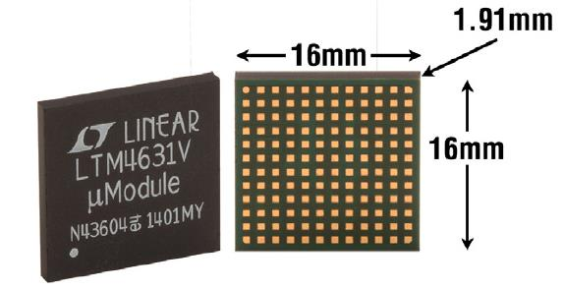
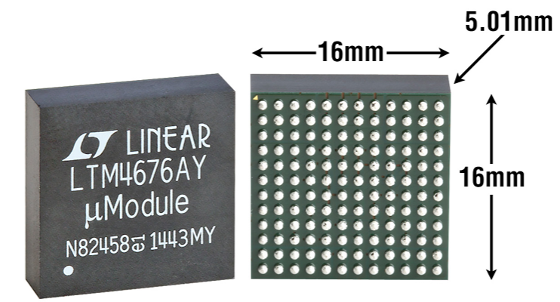
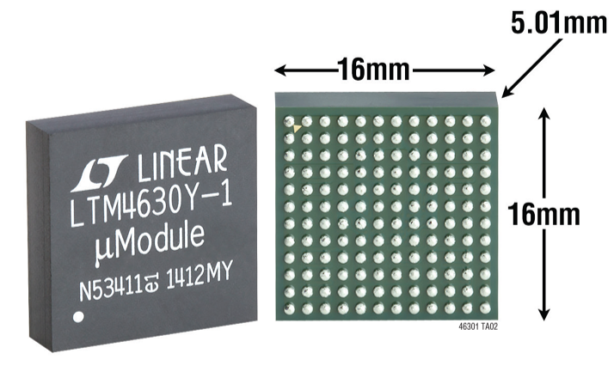
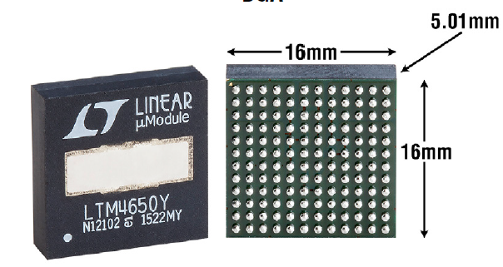
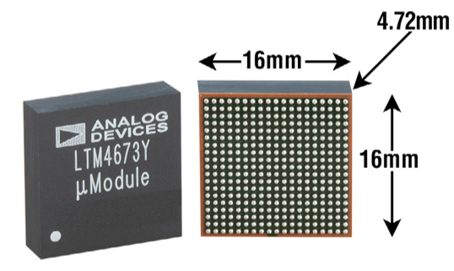
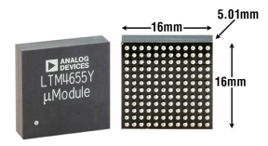
16 x 16mm Over Molded µModule Regulators
Function | # of Output | Input Voltage (V) |  | Output Voltage (V) |  | Output Current (A) | Package |  |  | Part Number
 |  | Min | Max | Min | Max |  | Dimensions (mm) | Height (mm) | Package
Buck | 2 | 4.5 | 15 | 0.6 | 1.8 | Dual 10A or Single 20A | 16 x 16 | 1.91 2.51 | LGA BGA | LTM4631 Pin-compatible with LTM4628
 |  | 4.5 | 26.5 | 0.5 | 5.5 | Dual 13A or Single 26A | 16 x 16 | 5.01 | BGA | LTM4676A
 |  | 4.5 | 16 | 0.5 | 1.8 | Dual 18A or Single 36A | 16 x 16 | 5.01 | BGA | LTM4677
 |  | 4.5 | 15 | 0.6 | 1.8 | Dual 18A or Single 36A | 16 x 16 | 4.41 5.01 | LGA (only LTM4630) BGA | LTM4630 / LTM4630-1
 |  | 4.5 | 18 (after date code 1720*) | 0.6 | 8 (after date code 1720*) | Dual 18A or Single 36A | 16 x 16 | 4.41 5.01 | LGA BGA | LTM4630A
 |  | 4.5 | 15 | 0.6 | 1.8 | Dual 25A or Single 50A | 16 x 16 | 5.01 | BGA | LTM4650 / LTM4650-1
 |  | 4.5 | 16 | 0.6 | 5.5 | Dual 25A or Single 50A | 16 x 16 | 4.41 5.01 | LGA (only LTM4650A) BGA | LTM4650A / LTM4650A-1
 | 4 | 4.5 | 15 | 0.6 | 3.3 (@ 12A output) 5.5 (@ 5A output) | Dual 5A and Dual 12A | 16 X16 | 4.72 | BGA | LTM4673
Buck-Boost | 2 | 3.1 3.6 | 40 40 | 0.5 -0.5 | 26.5 -26.5 (Span from V_{IN} to V_{OUT} not to exceed 40V) | Dual 4A or Single 8A |  | 5.01 | BGA | LTM4655
µModule Regulators
Show me
High Vin
(≥40V)
Show me Ultrathin
Show me PMBus
Show me
Pin-Compatible
Show me
New Products
(2020,21,22)

Slide 5
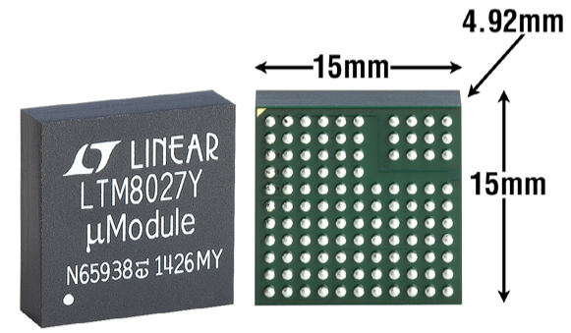
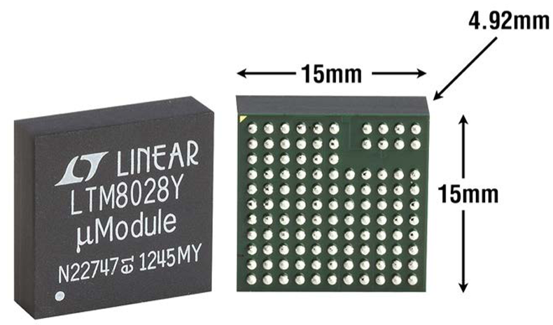
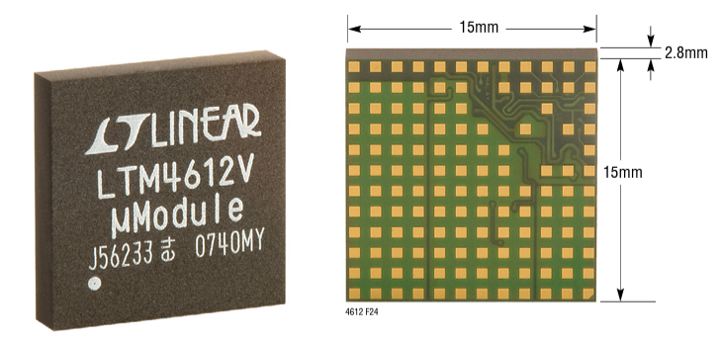
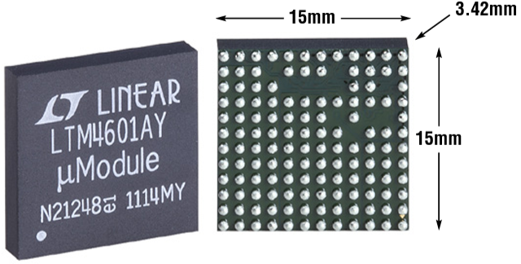
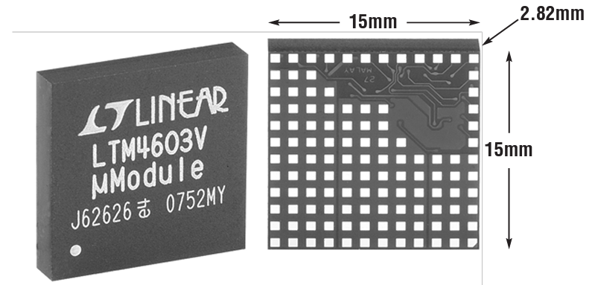
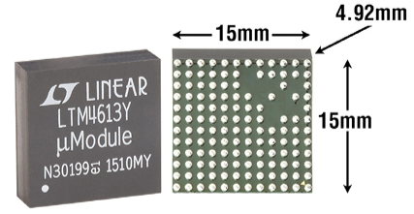
15 x 15mm µModule Regulators (4A-8A)
Function | # of Output | Input Voltage (V) |  | Output Voltage (V) |  | Output Current (A) | Package |  |  | Part Number
 |  | Min | Max | Min | Max |  | Dimensions (mm) | Height (mm) | Package
Buck | 1 | 4.5 | 60 | 2.5 | 24 | 4A | 15 x 15 | 4.32 4.92 | LGA BGA | LTM8027
 |  | 6 | 36 | 0.8 | 1.8 | 5A | 15 x 15 | 4.92 | BGA | LTM8028
 |  | 5 | 36 | 3.3 | 15 | 5A | 15 x 15 | 2.8 | LGA | LTM4612
 |  | 4.5 | 28 | 0.6 | 5 | 6A | 15 x 15 | 2.82 3.42 | LGA BGA | LTM4606
 |  | 4.5 | 20 28 (HV) | 0.6 | 5 | 6A | 15 x 15 | 2.8 | LGA | LTM4602/ LTM4602HV Pin-compatible with LTM4600
 |  | 4.5 | 20 28 (HV) | 0.6 | 5 | 6A | 15 x 15 | 2.82 | LGA | LTM4603/ LTM4603HV Pin-compatible with LTM4601
Buck | 1 | 5 | 36 | 3.3 | 15 | 8A | 15 x 15 | 4.32 4.92 | LGA BGA | LTM4613
 |  |  | 20 28 (HV) | 0.6 | 5 | 10A |  | 2.82 | LGA | LTM4600/ LTM4600HV
Buck | 2, 3, 5
Buck-Boost | 1
µModule Regulators
Click: Show me 15 x15mm Buck (10A-20A)
Click: Show me 15 x15mm Multiple Outputs
Click: Show me 15 x15mm Buck-Boost
Show me
High Vin
(≥40V)
Show me
EN55022 Class B
Show me
Pin-Compatible

Slide 6
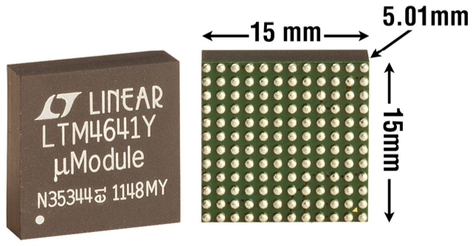
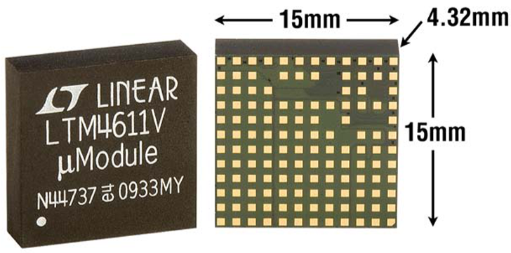
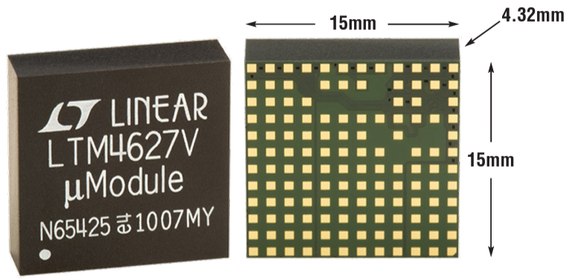
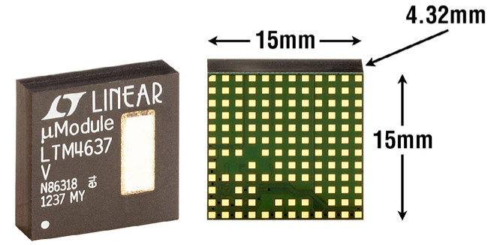
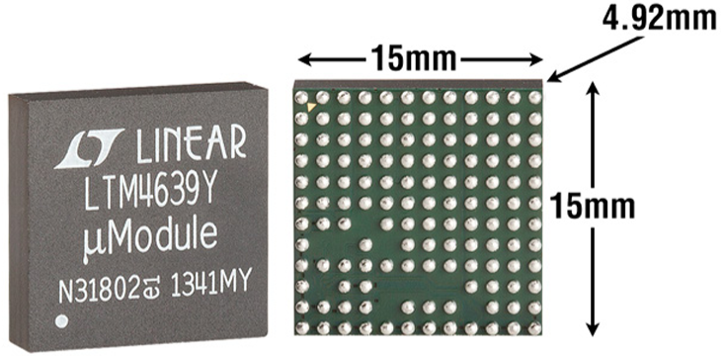
15 x 15mm µModule Regulators (10A-20A)
Function | # of Output | Input Voltage (V) |  | Output Voltage (V) |  | Output Current (A) | Package |  |  | Part Number
 |  | Min | Max | Min | Max |  | Dimensions (mm) | Height (mm) | Package
Buck | 1
 |  | 4.5 | 20 28 (HV) | 0.6 | 5 | 10A | 15 x 15 | 2.82 | LGA | LTM4600/ LTM4600HV (Pin-compatible with LTM4602)
 |  | 4.5 | 20 28 (HV) | 0.6 | 5 | 12A | 15 x 15 | 2.82 3.42 | LGA BGA | LTM4601 / LTM4601-1 LTM4601A / LTM4601A-1 LTM4601HV / LTM4601AHV (Pin-compatible with LTM4603)
 |  | 4.5 | 38 | 0.6 | 6 | 10A |  | 5.01 | BGA | LTM4641
 |  | 1.5 | 5.5 | 0.8 | 5 | 15A | 15 x 15 | 4.32 | LGA | LTM4611
 |  | 4.5 | 20 | 0.6 | 5 | 15A | 15 x 15 | 4.32 4.92 | LGA BGA | LTM4627
 |  | 4.5 | 20 | 0.6 | 5.5 | 20A | 15 x 15 | 4.32 4.92 | LGA BGA | LTM4637
 |  | 2.375 Vin < 4.5V, Need Cpwr Bias | 7 | 0.6 | 5.5 | 20A | 15 x 15 | 4.92 | BGA | LTM4639
Buck | 2, 3, 5
Buck-Boost | 1
µModule Regulators
Click: Show me 15 x15mm Buck <10A
Click: Show me 15 x15mm Multiple Outputs
Click: Show me 15 x15mm Buck-Boost
Show me
Low Vin
(≤3V)
Show me
Pin-Compatible

Slide 7
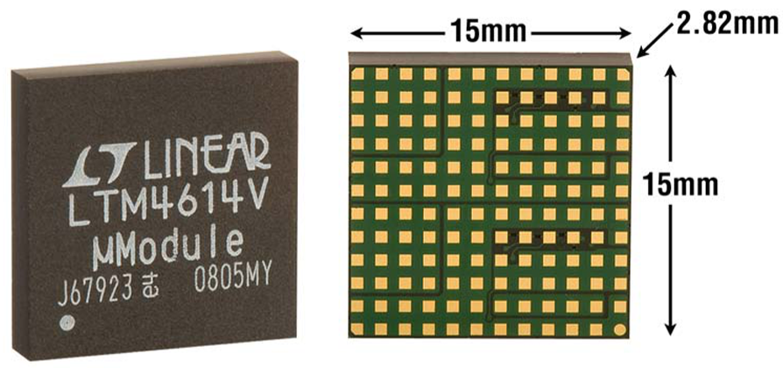
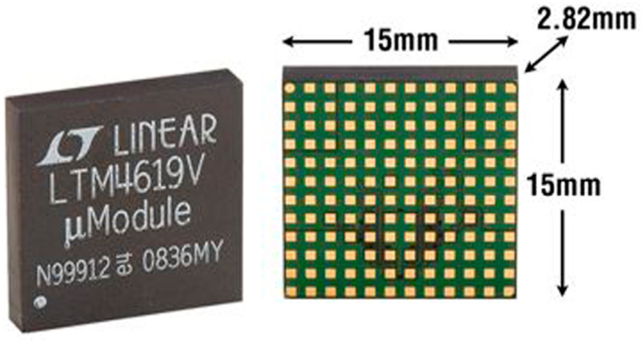
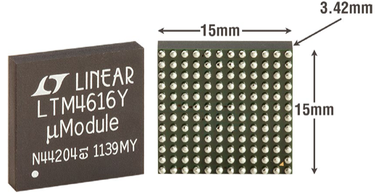
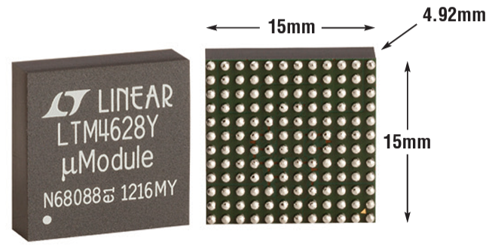
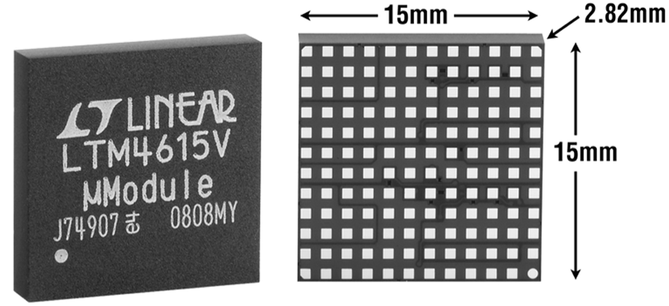
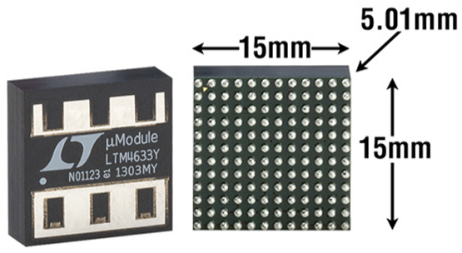
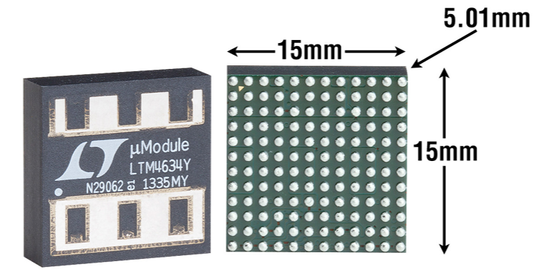
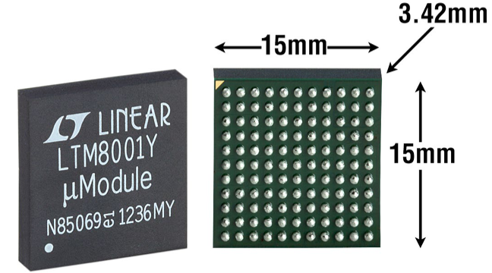
15 x 15mm µModule Regulators (Multi-Outputs)
Function | # of Output | Input Voltage (V) |  | Output Voltage (V) |  | Output Current (A) | Package |  |  | Part Number
 |  | Min | Max | Min | Max |  | Dimensions (mm) | Height (mm) | Package
Buck | 1
Buck | 2 | 2.375 | 5.5 | 0.8 | 5 | Dual 4A or Single 8A | 15 x 15 | 2.82 | LGA | LTM4614
 |  | 4.5 | 26.5 | 0.8 | 5 | Dual 4A or Single 8A | 15 x 15 | 2.82 | LGA | LTM4619
 |  | 2.7 | 5.5 | 0.6 | 5 | Dual 8A or Single 16A | 15 x 15 | 2.82 3.42 | LGA BGA | LTM4616
 |  | 4.5 | 26.5 | 0.6 | 5.5 | Dual 8A or Single 16A | 15 x 15 | 4.32 4.92 | LGA BGA | LTM4628 (pin-compatible with LTM4631)
 |  | 4.5 | 16 | 0.6 | 2.5 5.3 | Dual 13A or Single 26A | 15 x 15 | 4.41 5.01 | LGA BGA | LTM4620/ LTM4620A
 | 3 | 2.375 | 5.5 | 0.8 | 5 | Dual 4A with 1.5A VLDO | 15 x 15 | 2.82 | LGA | LTM4615
 | 3 | 4.7 2.375 with External 5V Bias | 16 | 0.8 | 1.8 5.5 | Triple 10A or 20A + 10A | 15 x 15 | 5.01 | BGA | LTM4633
 |  | 4.75 | 28 | 0.8 | 5.5 (@5A output) 13.5 (@4A output) | 5A, 5A, 4A | 15 x 15 | 5.01 | BGA | LTM4634
 | 5 | 6 | 36 | 0 | 24 | 5x 1.1A Parallelable Outputs | 15 x 15 | 3.42 | BGA | LTM8001
Buck-Boost | 1
µModule Regulators
Click: Show me 15 x15mm Buck <10A
Click: Show me 15 x15mm Buck >8A
Click: Show me 15 x15mm Buck-Boost
Show me
Low Vin
(≤3V)
Show me
Pin-Compatible

Slide 8
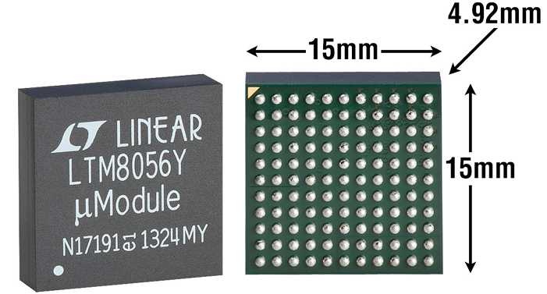
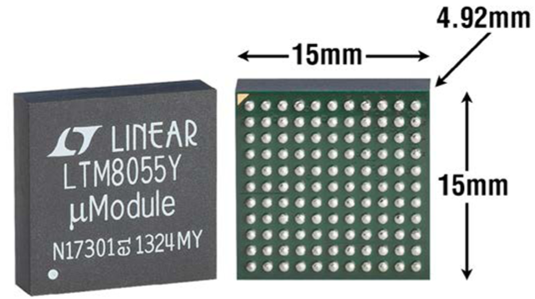
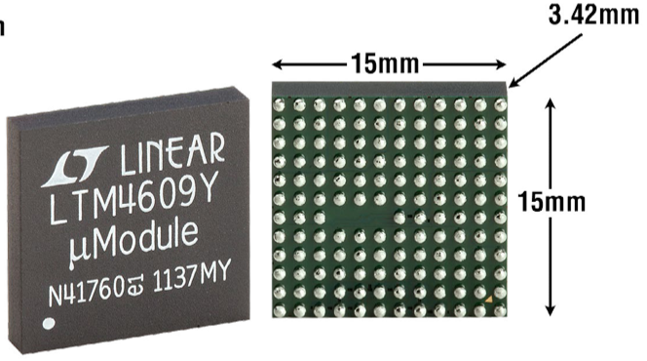
15 x 15mm µModule Regulators (Buck-Boost)
Function | # of Output | Input Voltage (V) |  | Output Voltage (V) |  | Output Current (A) | Inductor | Package |  |  | Part Number
 |  | Min | Max | Min | Max |  |  | Dimensions (mm) | Height (mm) | Package
Buck | 1
 | 2,3,5
Buck-Boost | 1 | 5 | 58 | 1.2 | 48 | 5.4A† | Internal | 15 x 15 | 4.92 | BGA | LTM8056
 |  | 5 | 36 | 1.2 | 36 | 8.5A† | Internal | 15 x 15 | 4.92 | BGA | LTM8055/LTM8055-1
 |  | 4.5 | 36 | 0.8 | 24 | 10A† | External | 15 x 15 | 2.8 | LGA | LTM4607
 |  | 4.5 | 36 | 0.8 | 34 | 10A† | External | 15 x 15 | 2.82 3.42 | LGA BGA | LTM4609
 |  | 4.5 | 20 | 0.8 | 16 | 12A† | External | 15 x 15 | 2.8 | LGA | LTM4605
µModule Regulators
Click: Show me 15 x15mm Buck <10A
Click: Show me 15 x15mm Buck >8A
Click: Show me 15 x15mm Multiple Outputs
Show me
High Vin
(≥40V)
Show me
Pin-Compatible
†Step-Down Mode. Output current varies depending on operation mode.

Slide 9
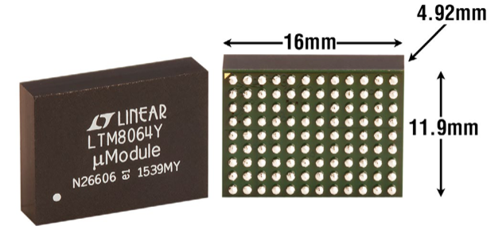
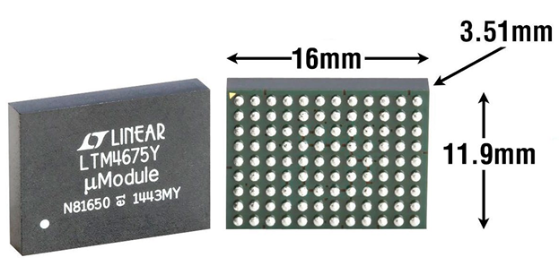
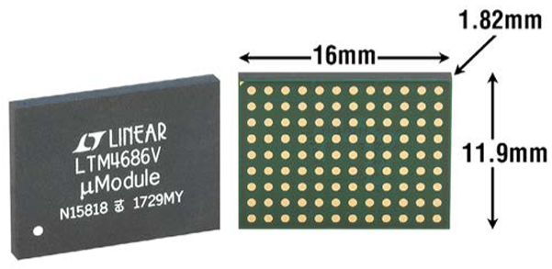
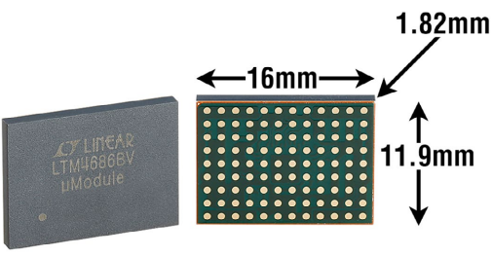
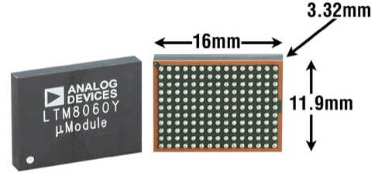
11.9 x 16mm µModule Regulators
µModule Regulators
Function | # of Output | Input Voltage (V) |  | Output Voltage (V) |  | Output Current (A) | Package |  |  | Part Number
 |  | Min | Max | Min | Max |  | Dimensions (mm) | Height (mm) | Package
Buck | 1 | 6 | 58 | 1.2 | 36 | ±6A | 11.9 x 16 | 4.92 | BGA | LTM8064
 | 2 | 4.5 | 17 | 0.5 | 5.5 | Dual 9A or Single 18A | 11.9 x 16 | 3.51 | BGA | LTM4675
 |  | 4.5 2.375 with Aux 5V Bias (LTM4686-1) | 17 | 0.5 | 3.6 | Dual 10A or Single 20A | 11.9 x 16 | 1.82 | LGA | LTM4686/LTM4686-1
 |  | 4.5 2.375 with Aux 5V Bias | 5.75 | 0.5 | 3.6 | Dual 14A or Single 28A |  | 1.82 | LGA | LTM4686B
 | 4 | 3 | 40 | 0.8 | 8 | Quad 3A, up to 12A | 11.9 x 16 | 3.32 | BGA | LTM8060
Show me PMBus
Show me
High Vin
(≥40V)
Show me
Pin-Compatible
Show me Ultrathin
Show me
New Products
(2021,22,23)

Slide 10
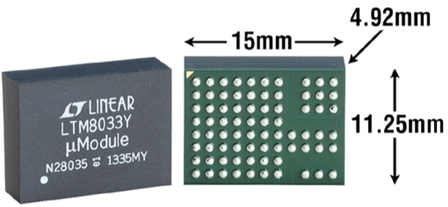
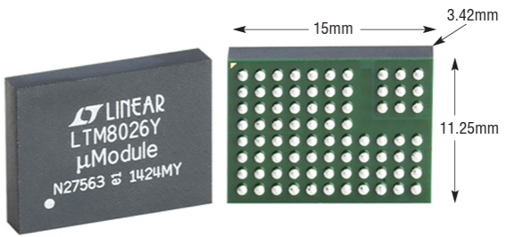
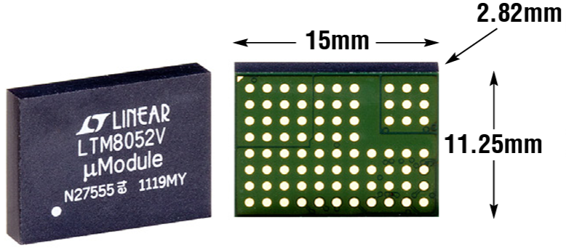
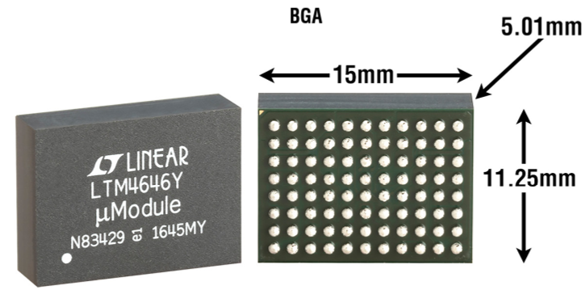
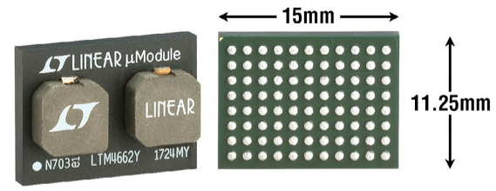
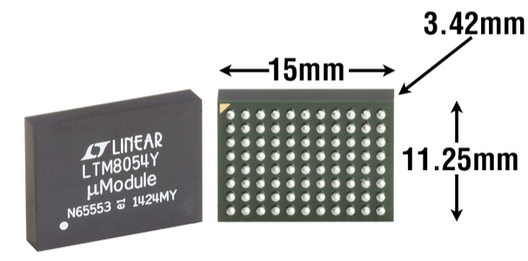
11.25 x 15mm µModule Regulators
µModule Regulators
Function | # of Output | Input Voltage (V) |  | Output Voltage (V) |  | Output Current (A) | Package |  |  | Part Number
 |  | Min | Max | Min | Max |  | Dimensions (mm) | Height (mm) | Package
Buck | 1 | 3.6 | 36 | 0.8 | 24 | 3A | 11.25 x 15 | 4.32 4.92 | LGA BGA | LTM8033
 |  | 6 | 36 | 1.2 | 24 | 5A |  | 2.82 3.42 | LGA BGA | LTM8026
 |  | 6 | 36 | 1.2 | 24 | ±5A |  | 2.82 3.42 | LGA BGA | LTM8052/LTM8052A
 | 2 | 4.5 2.375Vmin with CPWR Bias | 20 | 0.6 | 5.5 | Dual 10A or Single 20A | 11.9 x 16 | 5.01 | BGA | LTM4646
 |  | 4.5 2.375Vmin with CPWR Bias | 20 | 0.6 | 5.5 | Dual 15A or Single 30A | 11.9 x 16 | 5.74 | BGA | LTM4662
Buck-Boost | 1 | 5 | 36 | 1.2 | 36 | 5.4A† |  | 3.42 | BGA | LTM8054
†Step-Down Mode. Output current varies depending on operation mode.
Show me
Pin-Compatible
Show me
EN55022 Class B

Slide 11
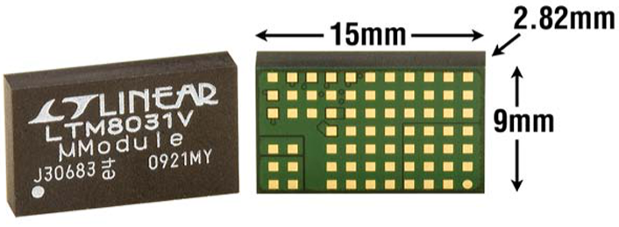
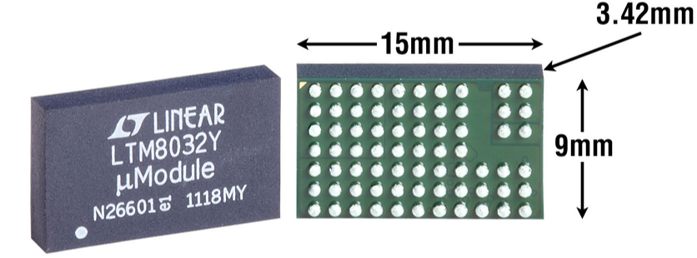
9 x 15mm µModule Regulators (1A-4A)
Function | # of Output | Input Voltage (V) |  | Output Voltage (V) |  | Output Current (A) | Package |  |  | Part Number
 |  | Min | Max | Min | Max |  | Dimensions (mm) | Height (mm) | Package
Buck | 1 | 3.6 | 36 | 0.8 | 10 | 1A | 9 x 15 | 2.82 | LGA | LTM8031
 |  | 3.6 | 36 | 0.8 | 10 | 2A | 15 x 15 | 2.82 3.42 | LGA BGA | LTM8032
 |  | 3.6 | 58 | 0.8 | 24 | 2A | 15 x 15 | 4.92 | BGA | LTM8050
 |  | 3.6 | 36 | 0.8 | 24 | 3A | 15 x 15 | 4.32 4.92 | LGA BGA | LTM8025
 |  | 2.375 | 5.5 | 0.8 | 5 | 4A | 15 x 15 | 2.32 3.42 | LGA BGA | LTM4604A
 |  | 3.1 | 58 | 0.5 | 0.94*V_{IN} | 4A | 15 x 15 | 5.01 | BGA | LTM4653
 |  |  | 20 28 (HV) | 0.6 | 5 | 10A |  | 2.82 | LGA | LTM4600/ LTM4600HV
Buck | 4
µModule Regulators
Click: Show me 9 x15mm Buck >4A
Click: Show me 9 x15mm Multiple Outputs
Show me
Low Vin
(≤3V)
Show me
High Vin
(≥40V)
Show me
EN55022 Class B
Show me
Pin-Compatible

Slide 12
9 x 15mm µModule Regulators (6A-30A)
Function | # of Output | Input Voltage (V) |  | Output Voltage (V) |  | Output Current (A) | Package |  |  | Part Number
 |  | Min | Max | Min | Max |  | Dimensions (mm) | Height (mm) | Package
Buck | 1
 |  | 4.5 | 26.5 | 0.8 | 5 | 6A | 9 x 15 | 4.32 4.92 | LGA BGA | LTM4618
 |  | 2.7 | 5.5 | 0.6 | 5 | 8A |  | 2.82 3.42 | LGA BGA | LTM4608A
 |  | 2.375 | 5.5 | 0.6 | 5 | 10A |  | 4.92 | BGA | LTM4648
 |  | 4.5 | 16 | 0.6 | 3.3 | 10A | 15 x 15 | 4.92 | BGA | LTM4649
 |  | 4.7 | 15 | 0.6 | 1.8 | 30A | 15 x 15 | 5.01 | BGA | LTM4647
Buck | 4
µModule Regulators
Click: Show me 9 x15mm Buck <6A
Click: Show me 9 x15mm Multiple Outputs
Show me
Low Vin
(≤3V)

Slide 13
7.5 x 15mm, 9 x 15mm, 9.5 x 16mm µModule Regulators (Multi-Outputs)
Function | # of Output | Input Voltage (V) |  | Output Voltage (V) |  | Output Current (A) | Package |  |  | Part Number
 |  | Min | Max | Min | Max |  | Dimensions (mm) | Height (mm) | Package
Buck | 1
Buck | 4 | 2.25 | 5.5 | 0.5 | V_{IN} | Quad: 10A | 7.5 x 15 | 4.65 | BGA | LTM4670
 |  | 4 2.375 with External Bias | 20 | 0.6 | 3.3 | Quad 3A, up to 12A | 9 x 15 | 1.82 2.42 | LGA BGA | LTM4643
 |  | 4 2.375 with External Bias | 14 | 0.6 | 5.5 | Quad 4A, up to 16A | 9 x 15 | 5.01 | BGA | LTM4644
 |  | 3.1 | 20 | 0.6 | 3.3V (for 12A Output) 5.5V (for 5A Output) | Quad: 5A, 5A, 12A, 12A | 9.5 x 16 | 4.72 | BGA | LTM4671
µModule Regulators
Click: Show me 9 x15mm Buck <6A
Click: Show me 9 x15mm Buck >4A
Show me
Low Vin
(≤3V)
Show me Ultrathin
Show me
Pin-Compatible
Show me
New Products
(2020,21,22)

Slide 14
9 x 11.25mm µModule Regulators (Step-Down)
Function | # of Output | Input Voltage (V) |  | Output Voltage (V) |  | Output Current (A) | Package |  |  | Part Number
 |  | Min | Max | Min | Max |  | Dimensions (mm) | Height (mm) | Package
Buck | 1 | 3.6 | 36 | 0.8 | 10 | 1A | 9 x 11.25 | 2.82 | LGA | LTM8022
 |  | 3.6 | 36 | 0.8 | 10 | 2A | 15 x 15 | 2.82 3.42 | LGA BGA | LTM8023
 |  | 3.6 | 60 | 0.97 | 15 | 5A | 15 x 15 | 3.32 | BGA | LTM8071
 | 2 | 3 | 40 | 0.8 | 8 | Dual 3.5A or Single 7A | 15 x 15 | 3.32 | BGA | LTM8024
 |  | 4.5 (2.375V with CPWR Bias) | 20 | 0.6 | 5.5 | Dual 4A or Single 8A | 15 x 15 | 4.92 | BGA | LTM4642
µModule Regulators
Show me
Low Vin
(≤3V)
Show me
High Vin
(≥40V)
Show me
Silent Switcher
Show me
Pin-Compatible

Slide 15
6.25 x 11.25mm µModule Regulators
µModule Regulators
Function | # of Output | Input Voltage (V) |  | Output Voltage (V) |  | Output Current (A) | Package |  |  | Part Number
 |  | Min | Max | Min | Max |  | Dimensions (mm) | Height (mm) | Package
Buck | 1 | 3 | 36 | 0.8 | 5 | 0.5A | 6.25 x 11.25 | 2.82 | LGA | LTM8021
 |  | 4.5 | 36 | 1.2 | 18 | 0.6A |  | 3.42 | BGA | LTM8029
 | 4 | 3 | 40 | 0.8 | 8 | Quad 1.2A, up to 4.8A | 16 x 16 | 2.22 | BGA | LTM8051
 |  | 2.5 | 5.5 | 0.5 | 3.6 | Quad 8A, up to 32A | 6 x 12 | 3.54 | BGA | LTM4710-1
Show me
Low Vin
(≤3V)
Show me
High Vin
(≥40V)
Show me
Silent Switcher

Slide 16
6.25 x 7.5mm and 6.25 x 9mm µModule Regulators
µModule Regulators
Function | # of Output | Input Voltage (V) |  | Output Voltage (V) |  | Output Current (A) | Package |  |  | Part Number
 |  | Min | Max | Min | Max |  | Dimensions (mm) | Height (mm) | Package
Buck | 1 | 3.4 | 60 | 0.8 | 15 | 3A | 6.25 x 9 | 3.32 | BGA | LTM8073
 |  | 3.4 | 40 | 0.97 | 18 | 3.5A |  | 3.32 | BGA | LTM8003
 |  | 3.4 | 40 | 0.97 | 15 | 3.5A |  | 3.32 | BGA | LTM8053
 | 2 | 3.5 | 40 | 0 | 8 | Dual 0.5A or Single 1A |  | 3.32 | BGA | LTM8080
 | 2 | 3.1 | 20 | 0.6 | 5.5 | Dual 5A or Single 10A | 6.25 x 7.5 | 3.22 | BGA | LTM4705
Show me
High Vin
(≥40V)
Show me
Silent Switcher
Show me
New Products
(2021,22,23)

Slide 17
6.25 x 6.25mm µModule Regulators (0.2A-5A)
Function | # of Output | Input Voltage (V) |  | Output Voltage (V) |  | Output Current (A) | Package |  |  | Part Number
 |  | Min | Max | Min | Max |  | Dimensions (mm) | Height (mm) | Package
Buck | 1 | 4 | 36 | 1.25 | 5 | 0.2A | 6.25 x 6.25 | 2.32 | LGA | LTM8020
 |  | 3.4 | 40 | 0.97 | 18 | 2.5A | 15 x 15 | 2.32 | BGA | LTM8065
 |  | 3.4 | 40 | 0.97 | 18 | 2.5A | 15 x 15 | 2.22 | BGA | LTM8002
 |  | 4 2.375 with External Bias | 20 | 0.6 | 5.5 | 3A | 15 x 15 | 1.82 2.42 | LGA BGA | LTM4623
 |  | 4 2.375 with External Bias | 14 | 0.6 | 5.5 | 4A | 15 x 15 | 5.01 | BGA | LTM4624
 |  | 4 2.375 with External Bias | 20 | 0.6 | 5.5 | 5A | 15 x 15 | 5.01 | BGA | LTM4625
Buck | 2, 3, 4
Others | 1
µModule Regulators
Click: Show me 6.25 x6.25mm Multiple Outputs
Click: Show me 6.25 x6.25 mm Boost & Buck-Boost
Show me
Low Vin
(≤3V)
Show me
High Vin
(≥40V)
Show me
Silent Switcher
Show me Ultrathin
Show me
Pin-Compatible

Slide 18
6.25 x 6.25mm µModule Regulators (Multi-Outputs)
Function | # of Output | Input Voltage (V) |  | Output Voltage (V) |  | Output Current (A) | Package |  |  | Part Number
 |  | Min | Max | Min | Max |  | Dimensions (mm) | Height (mm) | Package
Buck | 1
Buck | 2 | 3 | 40 | 0.8 | 10 | Dual 1.4A or Single 2.8A | 6.25 x 6.25 | 2.22 | BGA | LTM8078
 |  | 3.6 | 20 | 1.5 | 12 | Dual 2A or Single 4A |  | 1.82 2.42 | LGA BGA | LTM4622A
 |  | 3.6 (3.3 with V_{IN} tied to INTVcc) | 20 | 0.6 | 5.5 | Dual 2.5A or Single 5A | 9 x 15 | 1.82 2.42 | LGA BGA | LTM4622
 | 3 | 3.6 (3.3 with V_{IN} tied to INTVcc) | 15 | 0.6 | 2.5 | Dual ±3A with 10mA for VREF |  | 1.82 2.42 | LGA BGA | LTM4632
 | 4 | 2.7 | 17 | 0.6 | 1.8 (LTM4668) 5.5 (LTM4668A) | Quad 1.2A, up to 4.8A |  | 2.1 | BGA | LTM4668
Others | 1
µModule Regulators
Click: Show me 6.25 x6.25mm Single Output
Click: Show me 6.25 x 6.25mm Boost & Buck-Boost
Show me
Low Vin
(≤3V)
Show me
High Vin
(≥40V)
Show me
Silent Switcher
Show me Ultrathin
Show me
Pin-Compatible

Slide 19
6.25 x 6.25mm µModule Regulators (Boost & Buck-Boost)
µModule Regulators
Function | # of Output | Input Voltage (V) |  | Output Voltage (V) |  | Output Current (A) | Package |  |  | Part Number
 |  | Min | Max | Min | Max |  | Dimensions (mm) | Height (mm) | Package
Buck | 1
 | 2,3,4
Boost | 1 | 1.8 (down to 0.7V after start-up) | 5.5 | 2.5 | 15 | 4A | 6.25 x 6.25 | 2.42 | BGA | LTM4661
Buck-Boost |  | 3 | 36 | 1 | 36 | 1.5A |  | 2.22 | BGA | LTM8083
Click: Show me 6.25 x6.25mm Single Output
Click: Show me 6.25 x6.25mm Multiple Outputs
Show me
New Products
(2020,21,22)

Slide 20
6.25 x 6.25mm CoP µModule Regulators
Function | # of Output | Input Voltage (V) |  | Output Voltage (V) |  | Output Current (A) | Package |  |  | Part Number
 |  | Min | Max | Min | Max |  | Dimensions (mm) | Height (mm) | Package
Buck | 1 | 3 | 16 | 0.3 | 5.7 | 8A | 6.25 x 6.25 | 5.07 | BGA | LTM4702
Buck | 1 | 3.1 | 20 | 0.5 | 5.5 | 8A | 6.25 x 6.25 | 3.87 | BGA | LTM4657
 |  | 3.1 | 20 | 0.6 | 5.5 | 12A | 15 x 15 | 3.87 | BGA | LTM4626
 |  | 3.1 | 20 | 0.6 | 5.5 | 15A | 15 x 15 | 5.02 | BGA | LTM4638
µModule Regulators
Show me
Pin-Compatible
Show me
Silent Switcher

Slide 21
4 x 4mm and 4 x 6.25mm µModule Regulators
µModule Regulators
Function | # of Output | Input Voltage (V) |  | Output Voltage (V) |  | Output Current (A) | Package |  |  | Part Number
 |  | Min | Max | Min | Max |  | Dimensions (mm) | Height (mm) | Package
Buck | 1 | 3.2 | 40 | 0.8 | 12 | 1.2A | 4 x 4 | 1.82 | BGA | LTM8074
Buck-Boost |  | 2.25 | 5.5 | 0.5 | 5.5 | 10A |  | 4.32 | LGA | LTM4658
TEC (Thermoelectric Cooler) |  | 3.2 | 40 | 0.8 | 15 | 2A | 4 x 6.25 | 2.22 | BGA | LTM8063
Show me
Low Vin (<3V)
Show me
High Vin
(≥40V)
Show me
Silent Switcher
Show me Ultrathin
Show me
New Products
(2020,21,22)

Slide 22
3 x 4mm and 3.5 x 4mm µModule Regulators
µModule Regulators
Function | # of Output | Input Voltage (V) |  | Output Voltage (V) |  | Output Current (A) | Package |  |  | Part Number
 |  | Min | Max | Min | Max |  | Dimensions (mm) | Height (mm) | Package
Buck | 2 | 2.25 | 3.6 | 0.5 | 2.5 | Dual 2A | 3 x 4 | 1.18 1.48 | LGA BGA | LTM4691
Buck-Boost | 1 | 2.6 | 5.5 | 1.8 | 5.5 | 2A (Buck & Buck-Boost Mode) | 3.5 x 4 | 1.25 | LGA | LTM4693
TEC (Thermoelectric Cooler) | 1 | 2.7 | 5.5 | -V_{IN} | +V_{IN} | 1.5A | 3.5 x 4 | 1.3 | LGA | LTM4663
Show me
Low Vin (<3V)
Show me
New Products
(2020,21,22)

Slide 23
µModule Regulators <2mm tall (Ultrathin LGA)
µModule Regulators
Function | # of Output | Input Voltage (V) |  | Output Voltage (V) |  | Output Current (A) | Package |  |  | Part Number
 |  | Min | Max | Min | Max |  | Dimensions (mm) | Height (mm) | Package
Buck | 1 | 3.2 | 40 | 0.8 | 12 | 1.2A | 4 x 4 | 1.82 | BGA | LTM8074
 |  | 4 2.375 with External Bias | 20 | 0.6 | 5.5 | 3A | 6.25 x 6.25 | 1.82 2.42 | LGA BGA | LTM4623
 | 2 | 2.25 | 3.6 | 0.5 | 2.5 | Dual 2A | 3 x 4 | 1.18 1.48 | LGA BGA | LTM4691
 |  | 3.6 | 20 | 1.5 | 12 | Dual 2A or Single 4A | 6.25 x 6.25 | 1.82 2.42 | LGA BGA | LTM4622A
 |  | 3.6 3.3Vin Compatible with Vin tied to INTVcc | 20 | 0.6 | 5.5 | Dual 2.5A or Single 5A | 6.25 x 6.25 | 1.82 2.42 | LGA BGA | LTM4622
 |  | 4.5 | 15 | 0.6 | 1.8 | Dual 10A or Single 20A | 16 x 16 | 1.91 2.51 | LGA BGA | LTM4631
 |  | 4.5 (2.375 with Aux 5V Bias LTM4686-1) | 17 | 0.5 | 3.6 | Dual 10A or Single 20A | 11.9 x 16 | 1.82 | LGA | LTM4686/LTM4686-1
 | 4 | 4 2.375 with External Bias | 20 | 0.6 | 3.3 | Quad 3A or Single 12A | 9 x 15 | 1.82 2.42 | LGA BGA | LTM4643
DDR Termination | 3 | 3.6 3.3Vin Compatible with Vin tied to INTVcc | 15 | 0.6 | 2.5 | Dual 3A and 10mA for VREF | 6.25 x 6.25 | 1.82 2.42 | LGA BGA | LTM4632
Buck-Boost | 1 | 2.6 | 5.5 | 1.8 | 5.5 | 2A (Buck & Buck-Boost Mode) | 3.5 x 4 | 1.25 | LGA | LTM4693
TEC | 1 | 2.7 | 5.5 | -V_{IN} | +V_{IN} | 1.5A | 3.5 x 4 | 1.3 | LGA | LTM4663
Show me
Silent Switcher
Show me
Low Vin
Show me
High Vin
Show me PMBus
Show me
Pin-Compatible
Show me
New Products
(2020,21,22)

Slide 24
µModule Regulators ≤1.3mm tall (Ultrathin)
µModule Regulators
Function | # of Output | Input Voltage (V) |  | Output Voltage (V) |  | Output Current (A) | Package |  |  | Part Number
 |  | Min | Max | Min | Max |  | Dimensions (mm) | Height (mm) | Package
Buck | 2 | 2.25 | 3.6 | 0.5 | 2.5 | Dual 2A | 3 x 4 | 1.18 (BGA is 1.48) | LGA BGA | LTM4691
Buck-Boost | 1 | 2.6 | 5.5 | 1.8 | 5.5 | 2A (Buck & Buck-Boost Mode) | 3.5 x 4 | 1.25 | LGA | LTM4693
TEC (Thermoelectric Cooler) | 1 | 2.7 | 5.5 | -V_{IN} | +V_{IN} | 1.5A | 3.5 x 4 | 1.3 | LGA | LTM4663
Show me
Low Vin (<3V)
Show me
New Products
(2020,21,22)

Slide 25
Design Logic
Find the correct µModule Regulators by package size & height in 2-3 clicks
Logic & structure
Future updates:
LTM8045
LTM8057
LTM8067
LTM8068
LTM8058
LTM8047
LTM8048
LTM4651
LTM8049
LTM8046
LTM8061
LTM8042
LTM8062
LTM8040
LTM4652
Home Page
Clickable: x-y (CoP & over molded), z height
Add foot note: LGA vs BGA
Make sure picture is proportional
x-y is green box, z-height is yellow box
Product Table
Ultrathin parts
Include: function, # of output, Vin, Vout, Iout (sorted by), x-y, z, package, part number (with link), package photo
Clickable features: Silent Switcher, PMbus, ultrathin, high/low Vin, new product
Include: function, # of output, Vin, Vout, Iout (sorted by), x-y, z, package, part number (with link), package photo
Clickable features: Silent Switcher, PMbus, ultrathin, high/low Vin, new product

